Slide 1

www.kidsfirstcanada.org
info@kidsfirstcanada.org

Slide 2
URGENT REPORT
DATA MINING ALL BC RESIDENTS FROM “PRE-CONCEPTION”
KICK BIG BROTHER OUT OF SCHOOL
February 2024
Helen Ward

Slide 3
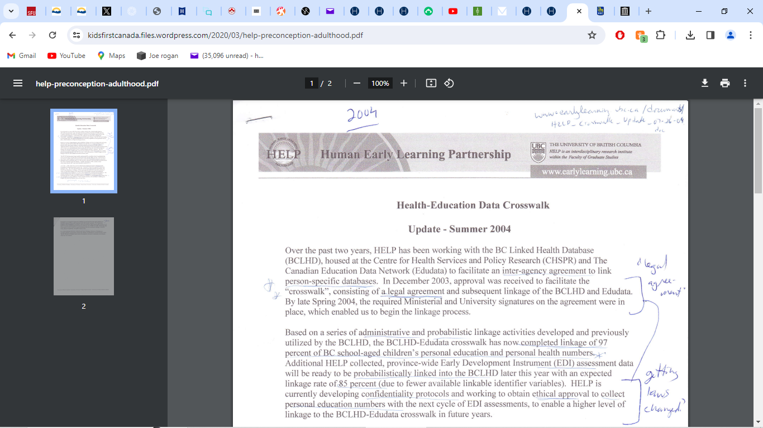

Slide 4
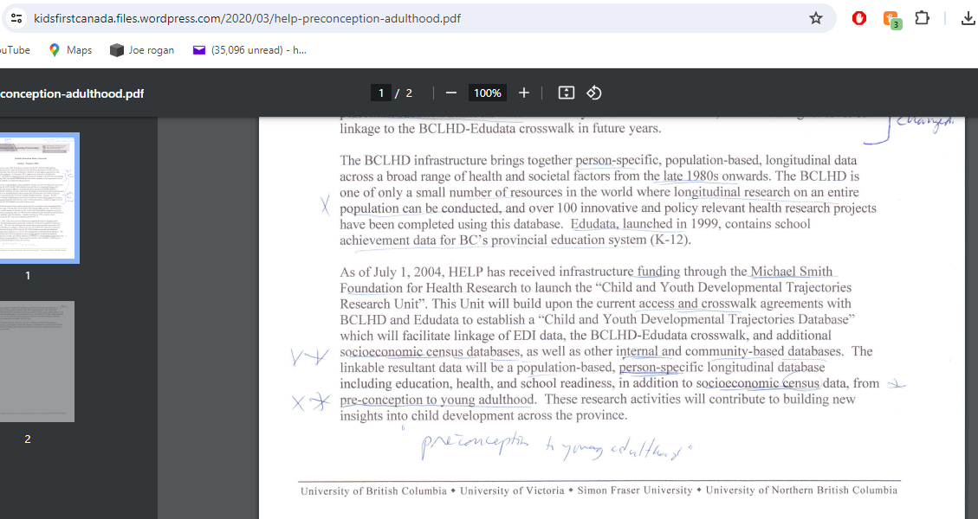

Slide 5
World Bank 2005
RBC VP Charlie Coffee speech
Early Child Development is a Business Imperative
“…early child development is being recognized ‘as an industry
worthy of investment and important to economic growth.
It has fostered new relationships with business and government policy makers
and economic development experts. It has the potential to spawn
new approaches to data collection, planning, professional development,
management, finance, government policy, and advocacy.’ “
https://documents1.worldbank.org/curated/en/536021468340243580/text/409250PAPER0Ea101OFFICIAL0USE0ONLY1.txt

Slide 6
POPULATION DATA BC www.popdata.bc.ca
Located at UBC
School of Population and Health
2206 East Mall, Vancouver BC

Slide 7
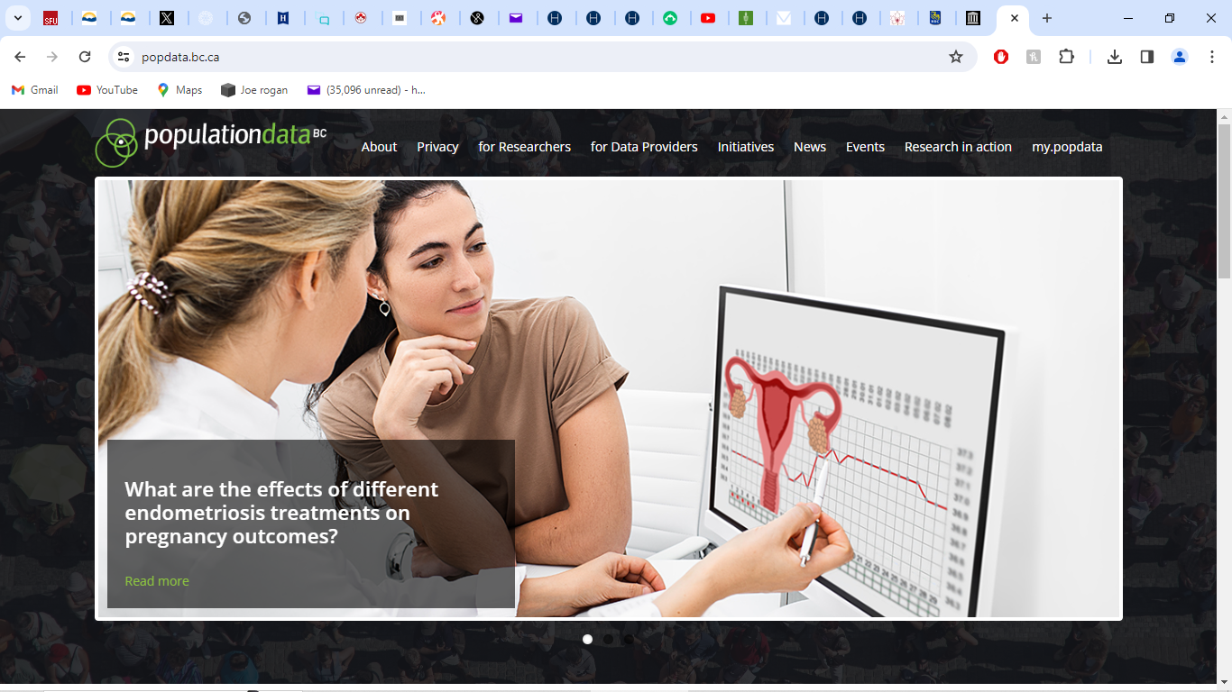

Slide 8
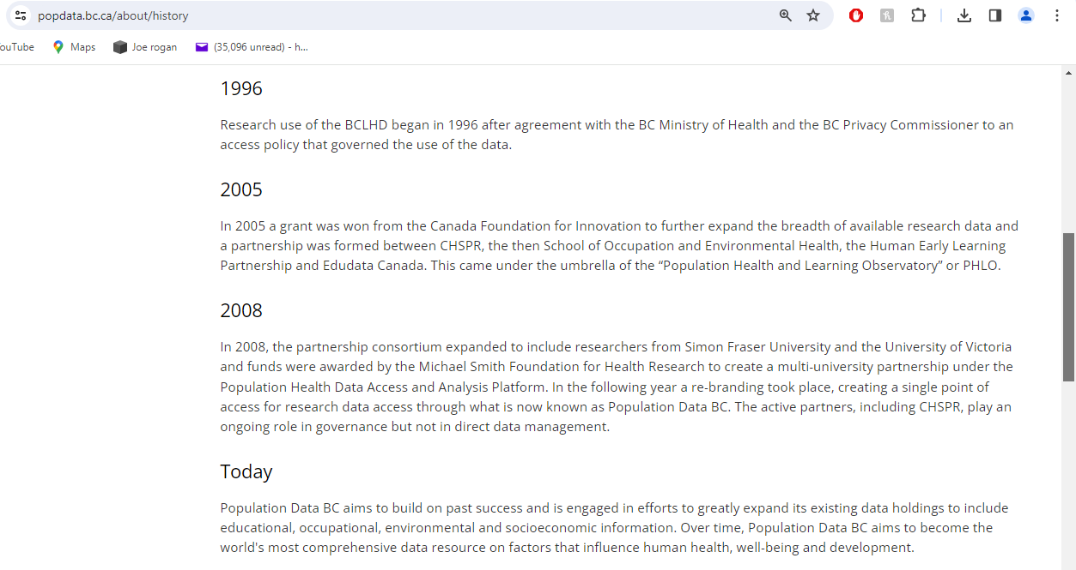

Slide 9
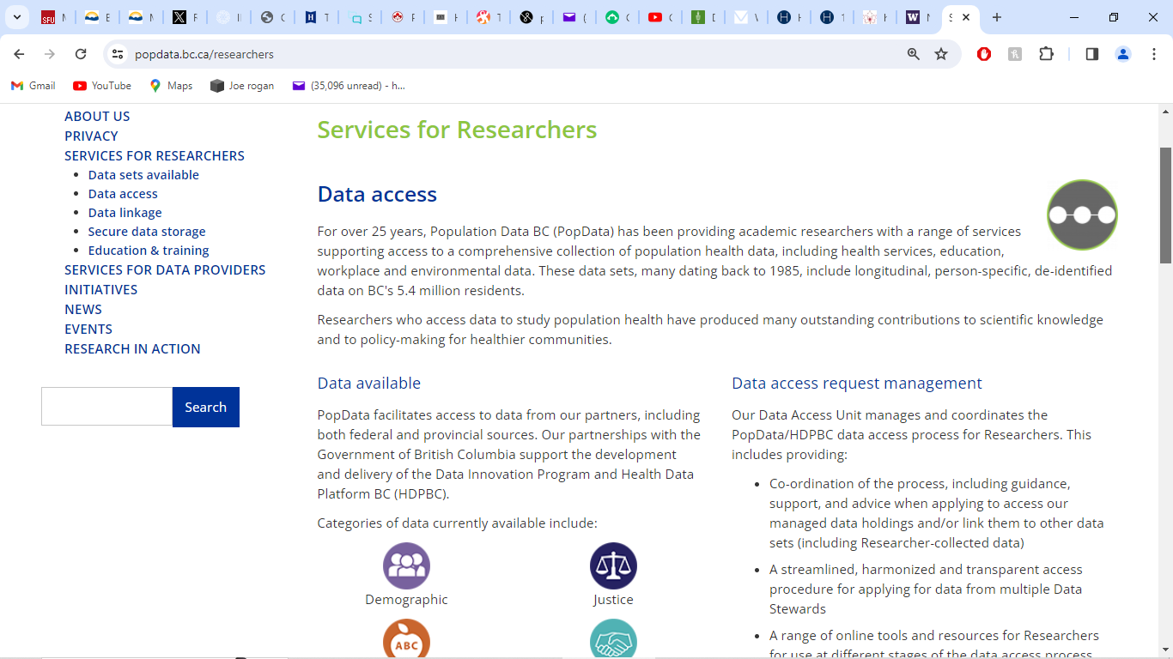

Slide 10
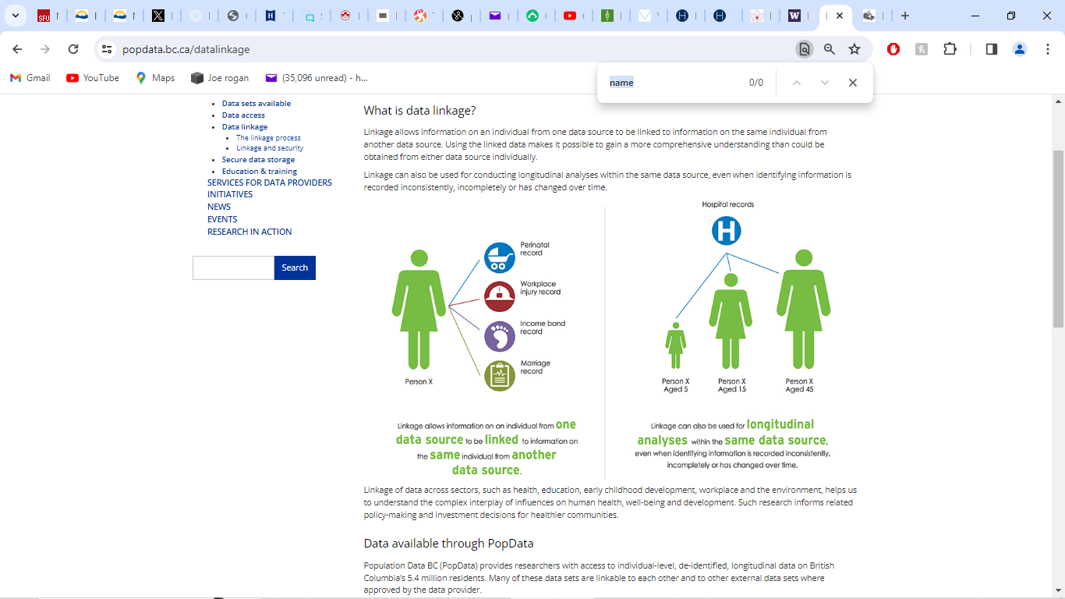

Slide 11
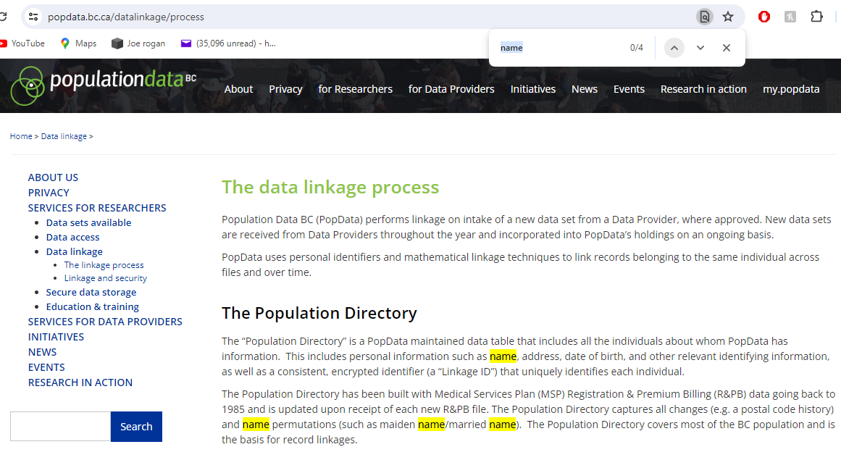

Slide 12
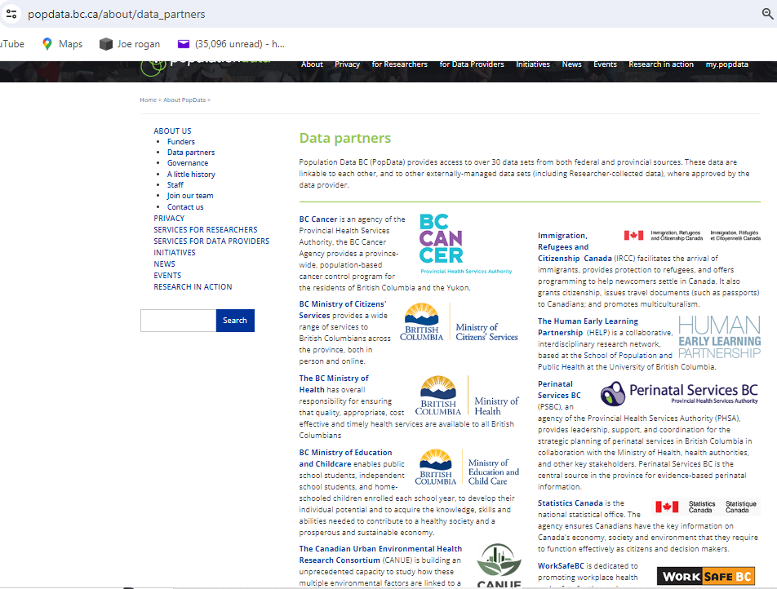

Slide 13
EXAMPLES OF DATA SETS LINKED by PopDataBC

Slide 14
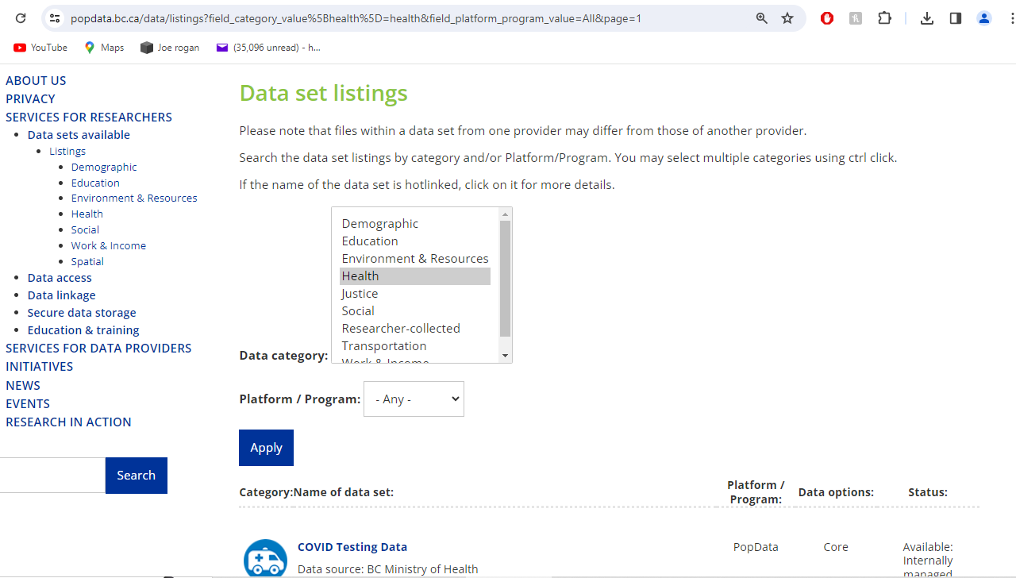

Slide 15
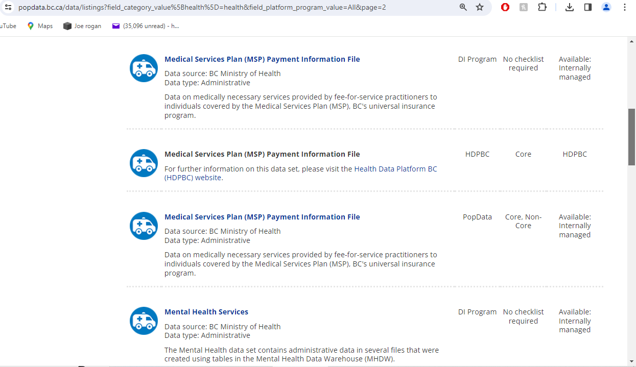

Slide 16
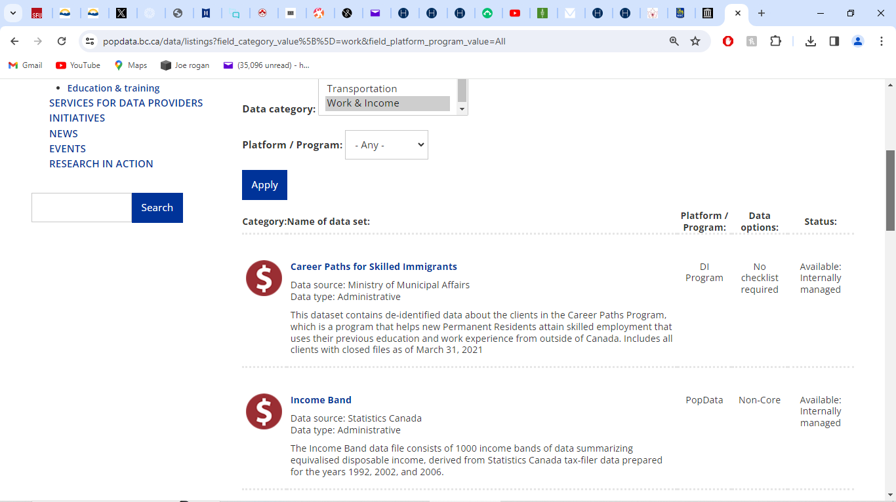

Slide 17
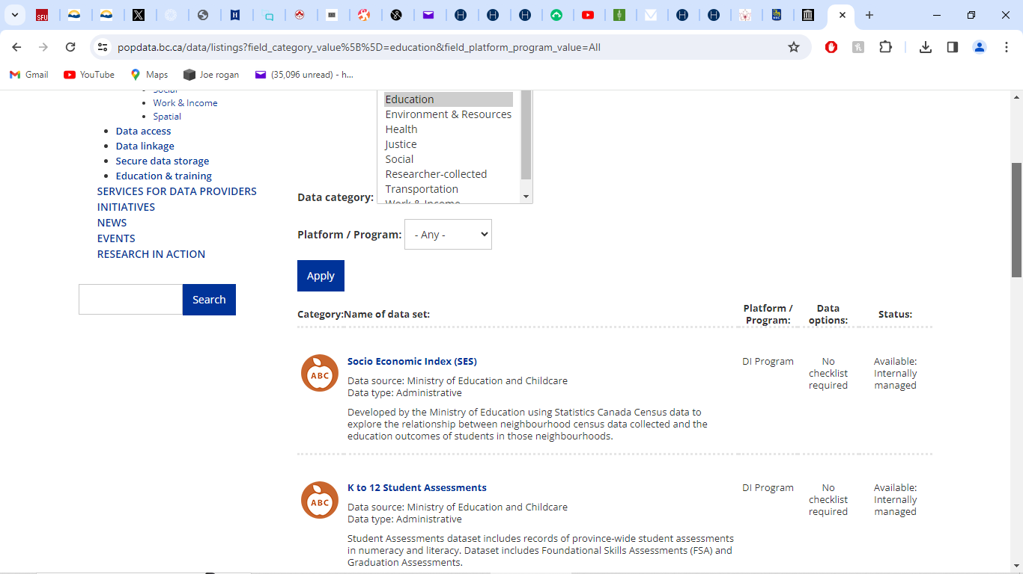

Slide 18
SELLING OUR DATA - ACCESS FEES

Slide 19
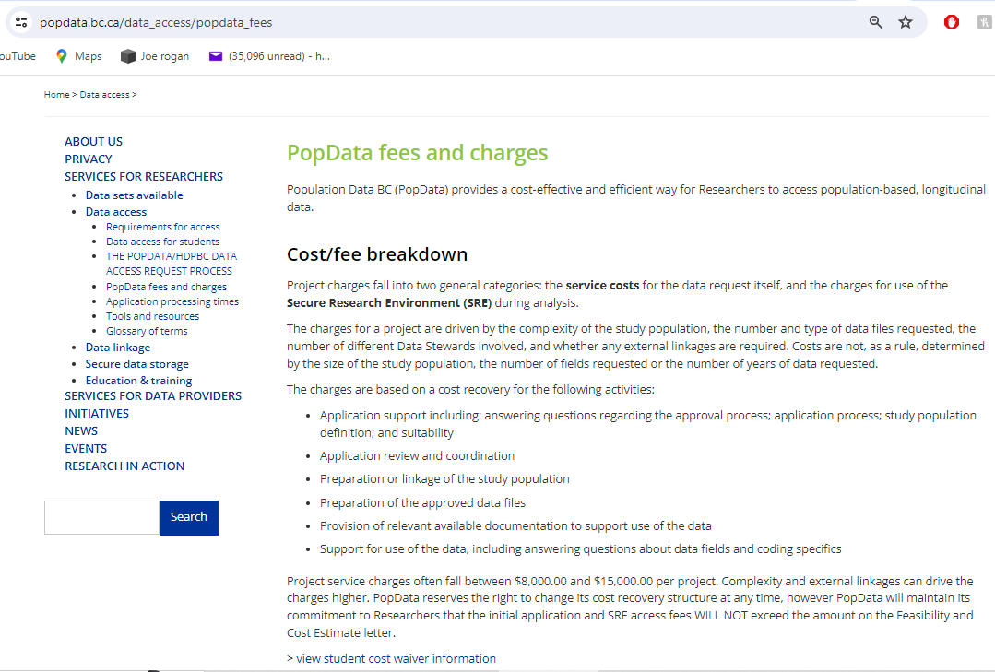

Slide 20
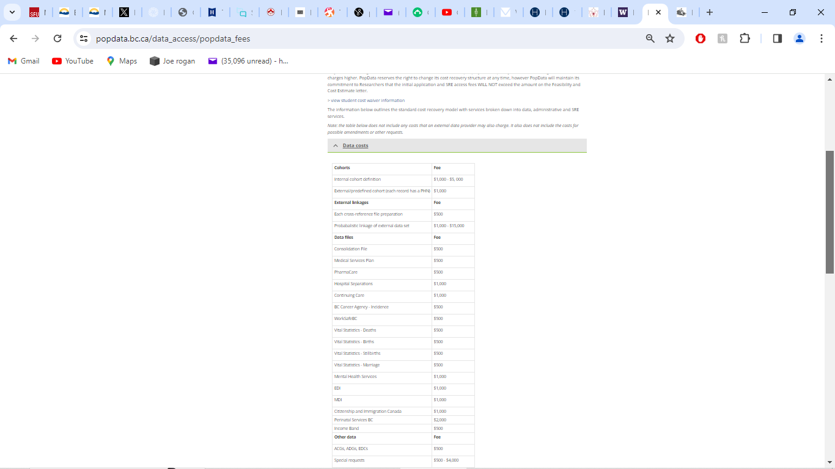

Slide 21
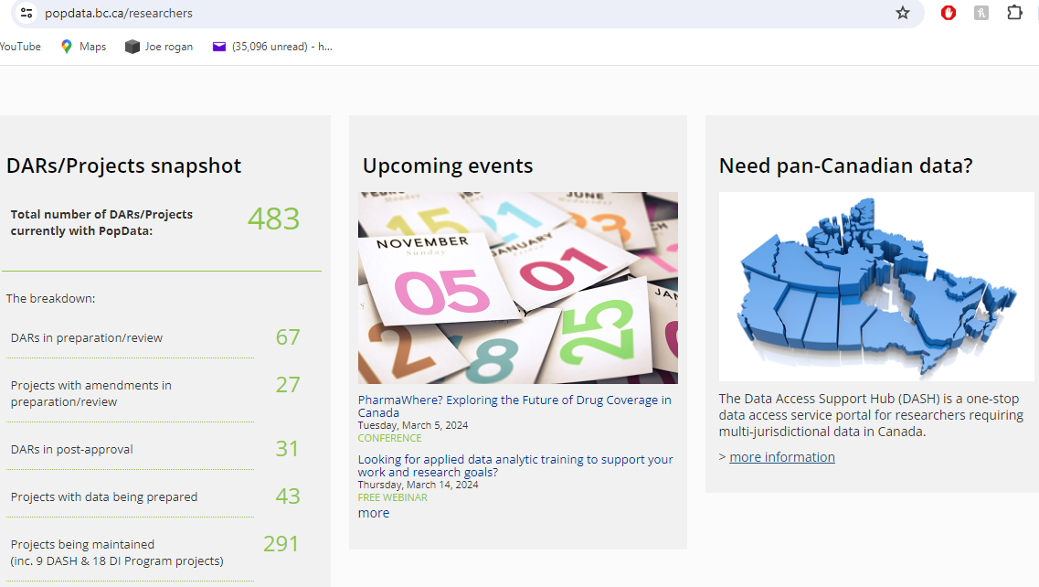

Slide 22
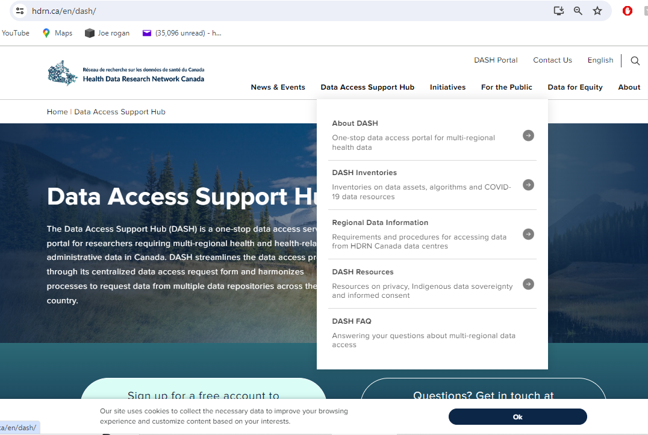

Slide 23
PopDataBC FUNDERS & GOVERNANCE

Slide 24
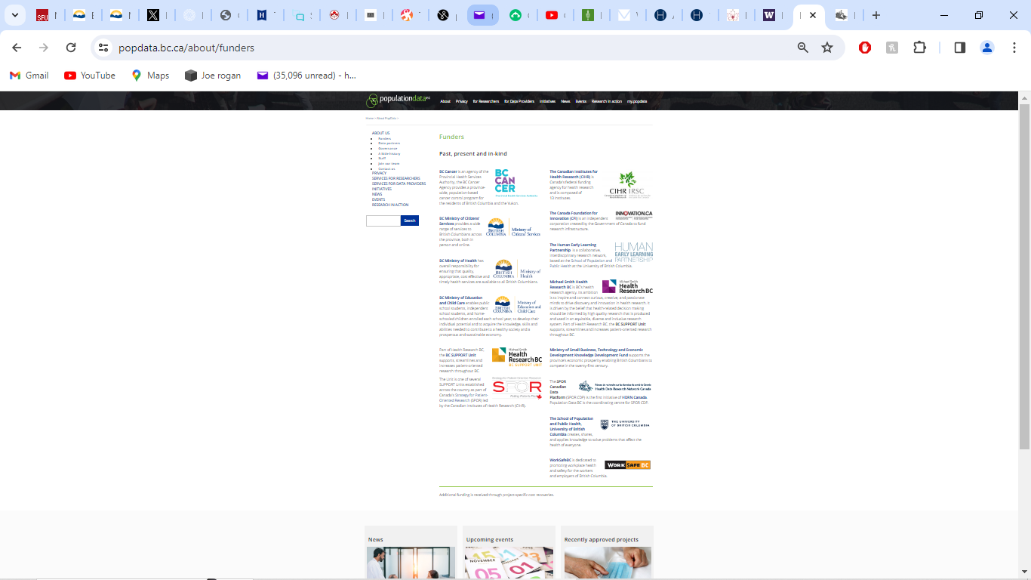

Slide 25
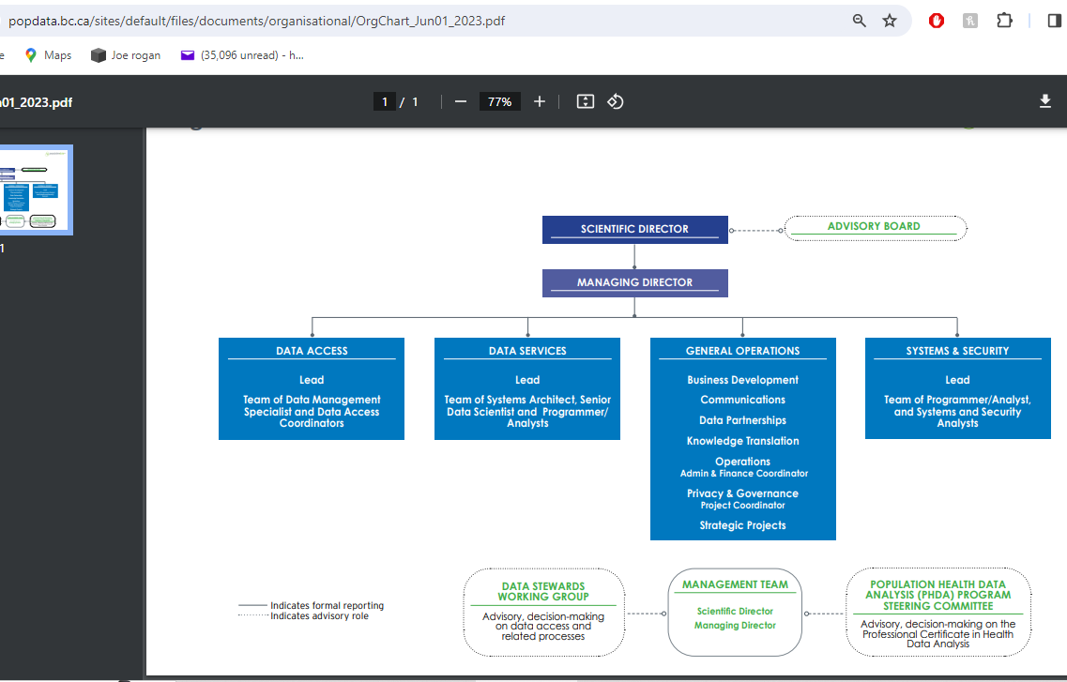

Slide 26
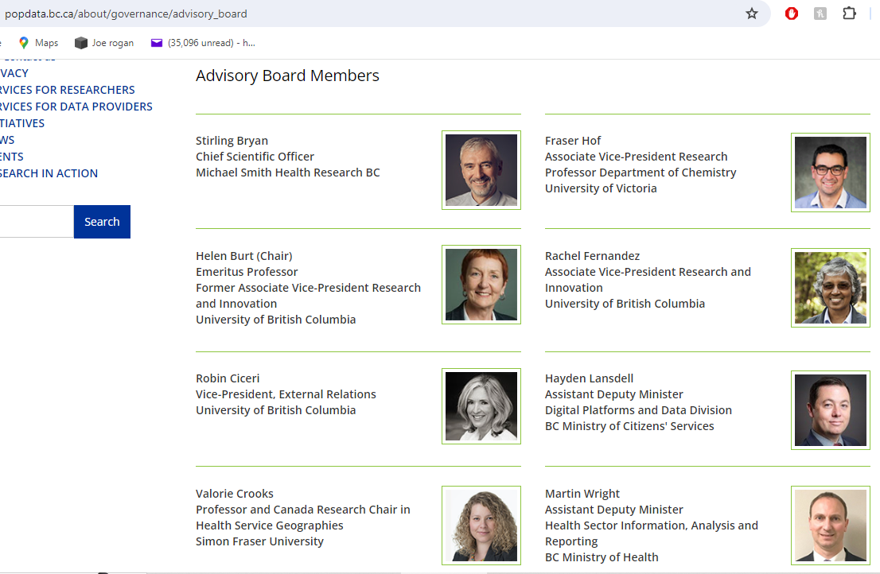

Slide 27
UBC’s Human Early Learning Partnership (HELP) &
EDI & MDI & YDI & CHEQ &TDI
EDI = Early Development Instrument
MDI = Middle-years Development Instrument
YDI = Youth Development Instrument
TDI = Toddler Development Instrument
CHEQ = Child Experiences Questionnaire

Slide 28
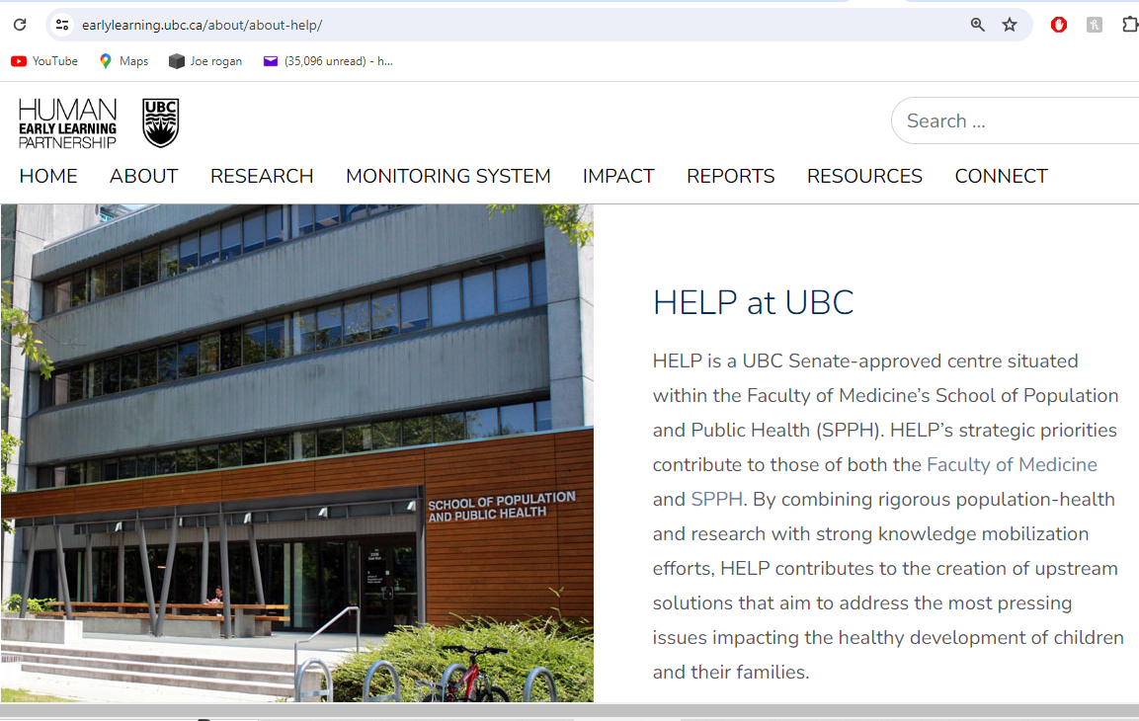

Slide 29
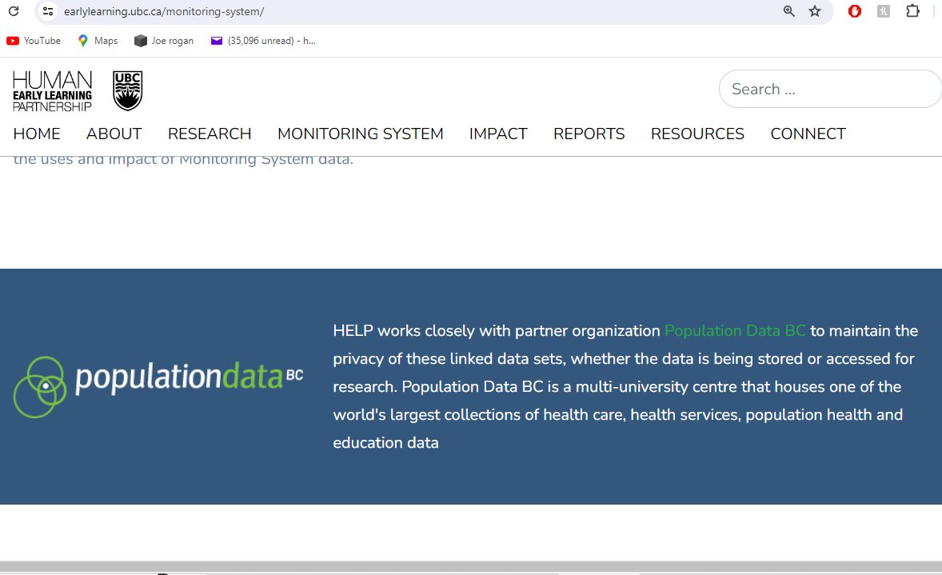

Slide 30
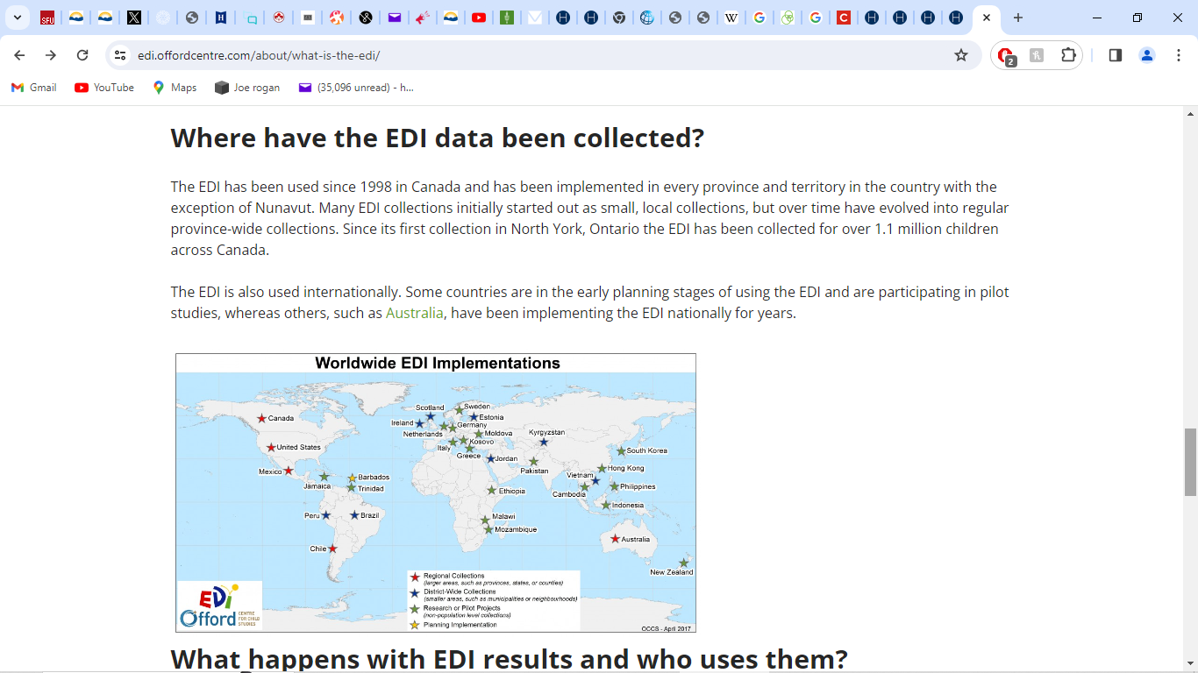

Slide 31
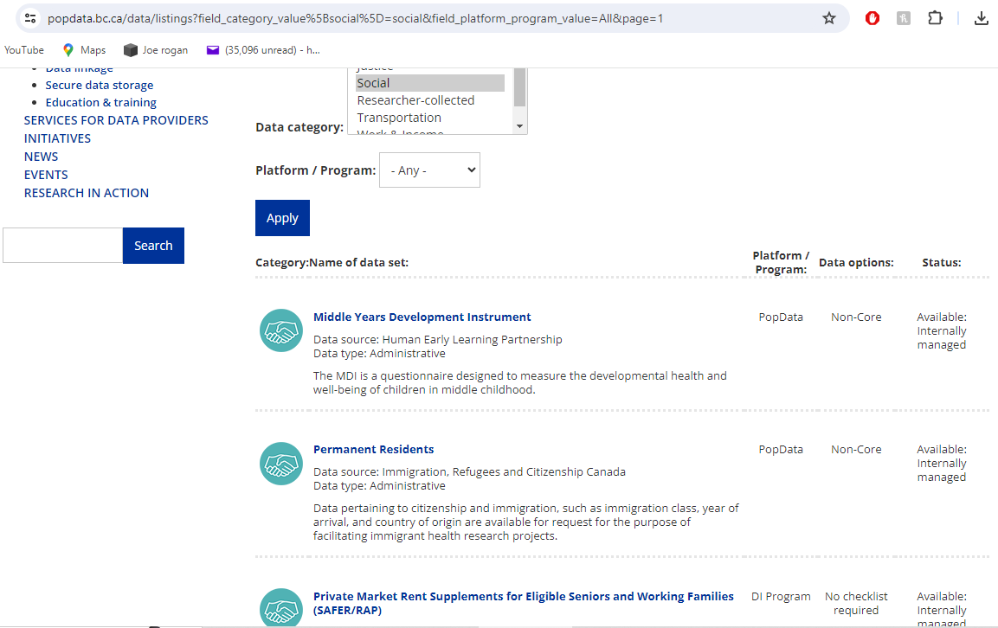

Slide 32
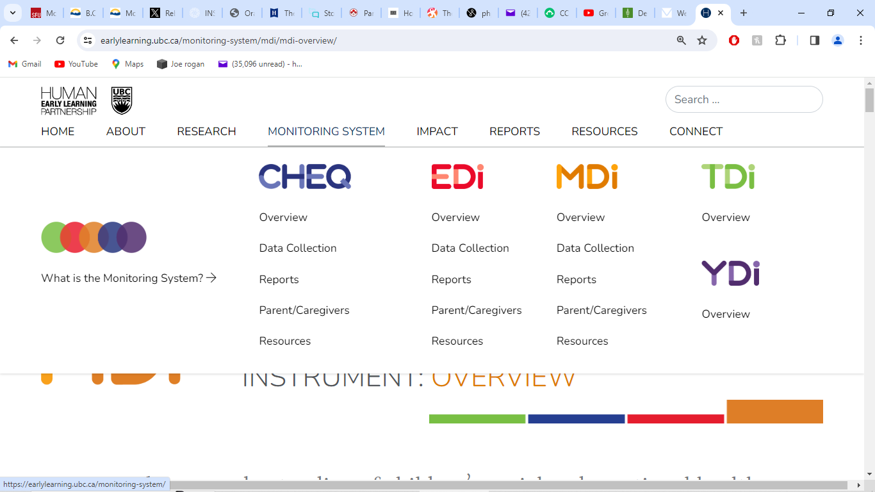

Slide 33
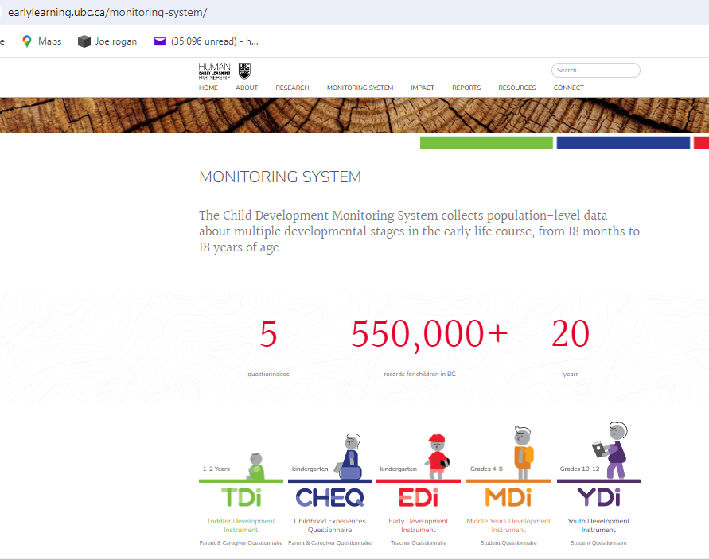

Slide 34
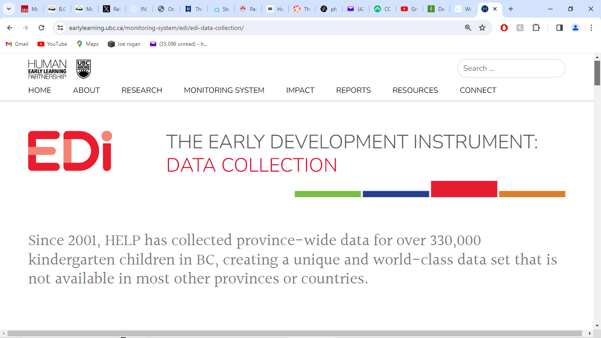

Slide 35
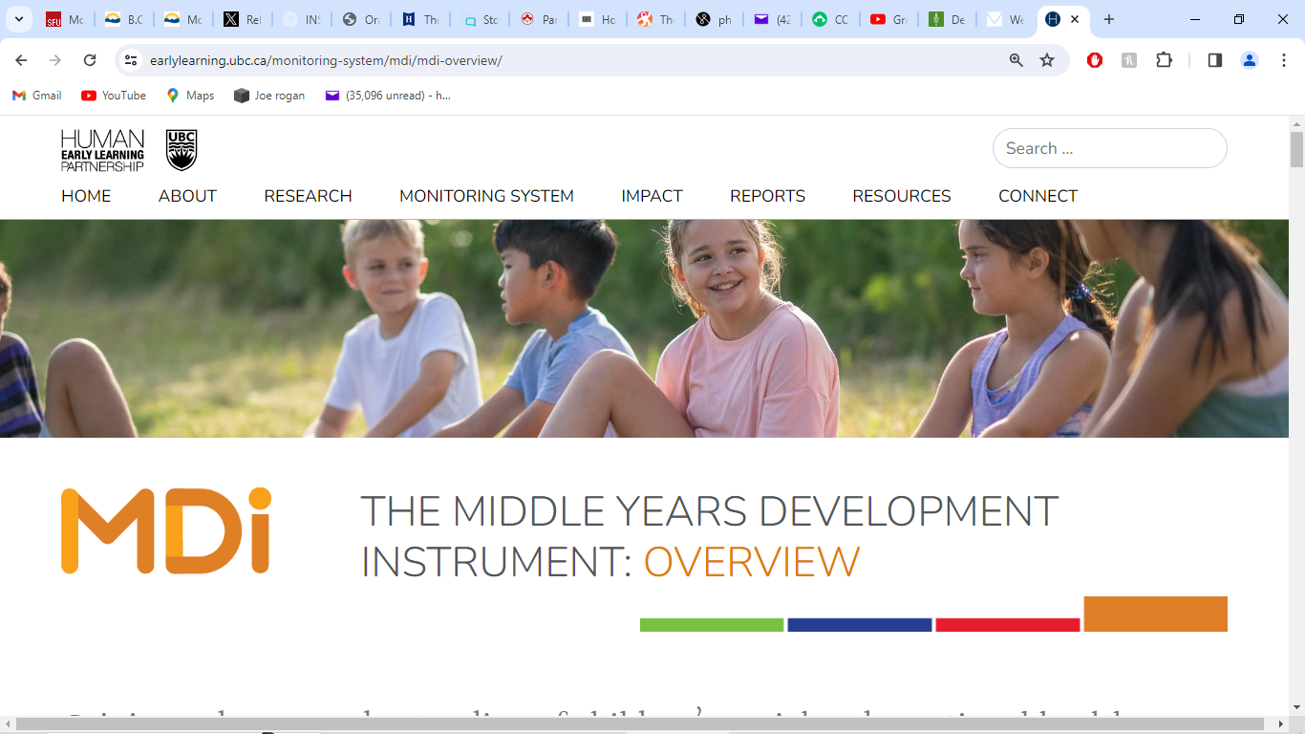

Slide 36
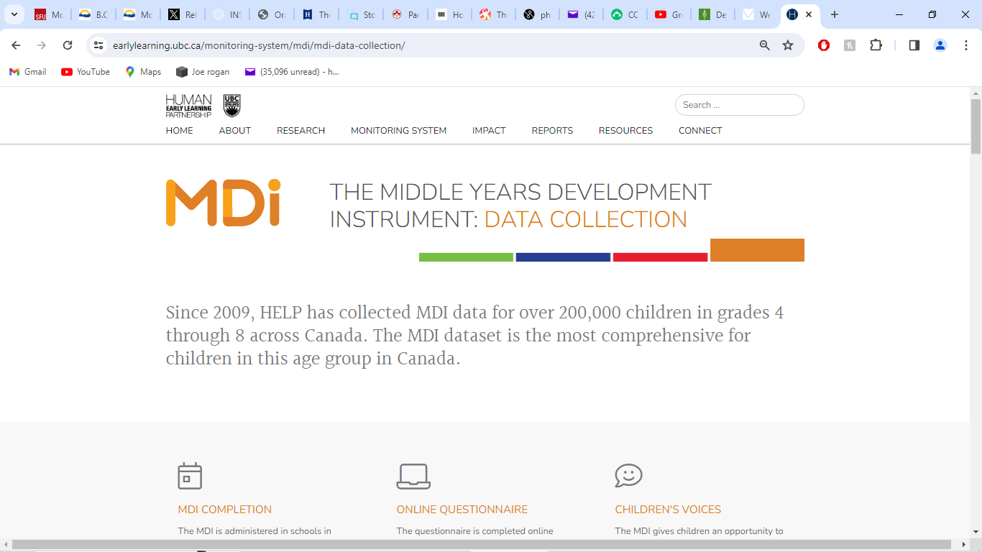

Slide 37
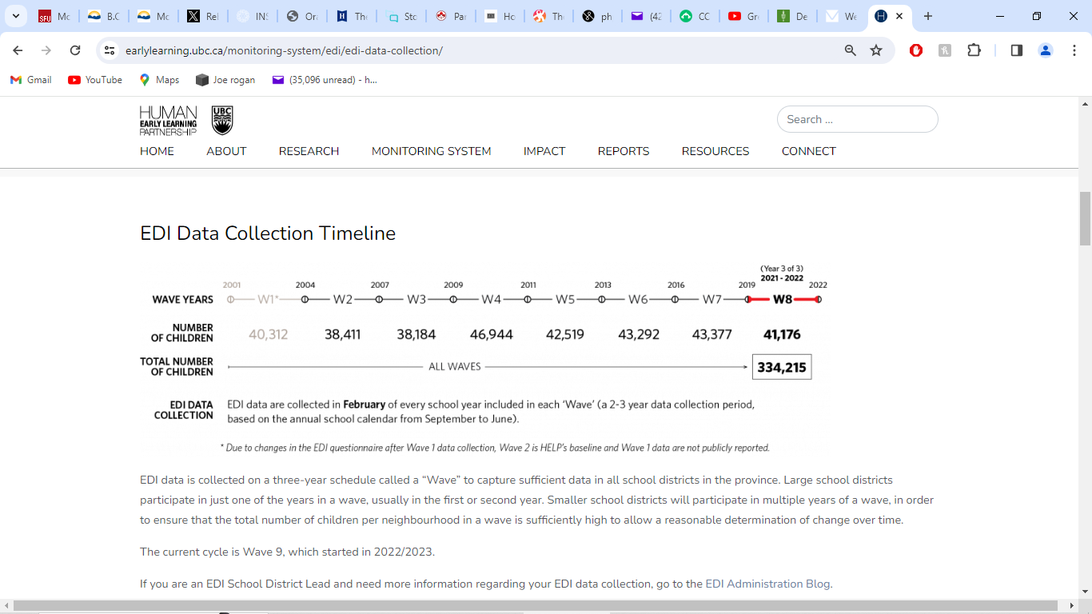

Slide 38
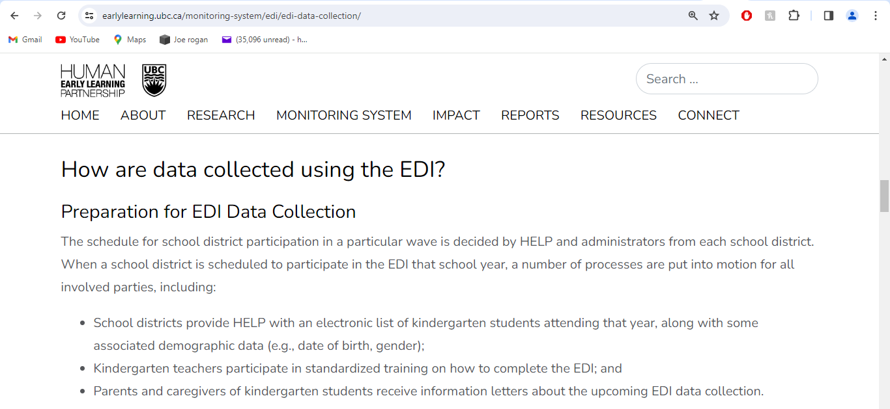

Slide 39
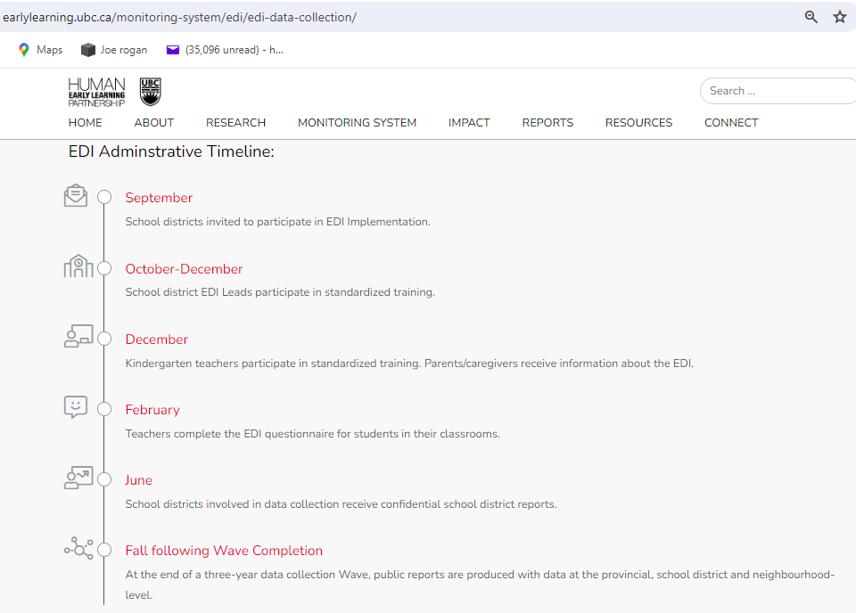

Slide 40
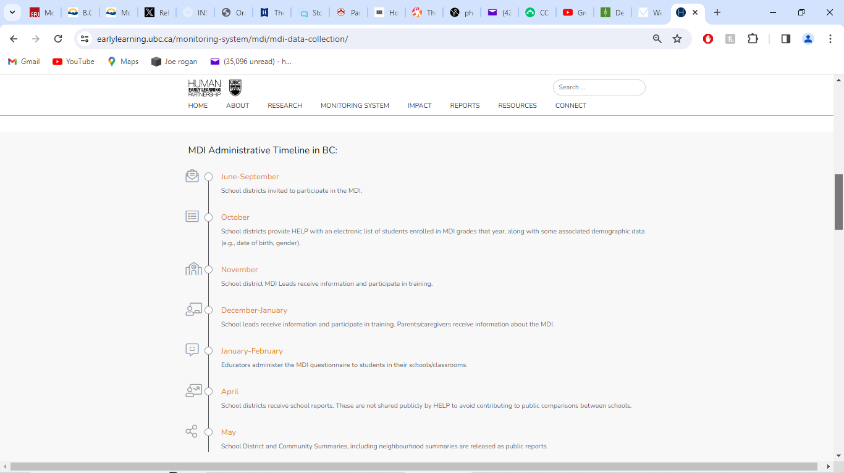

Slide 41
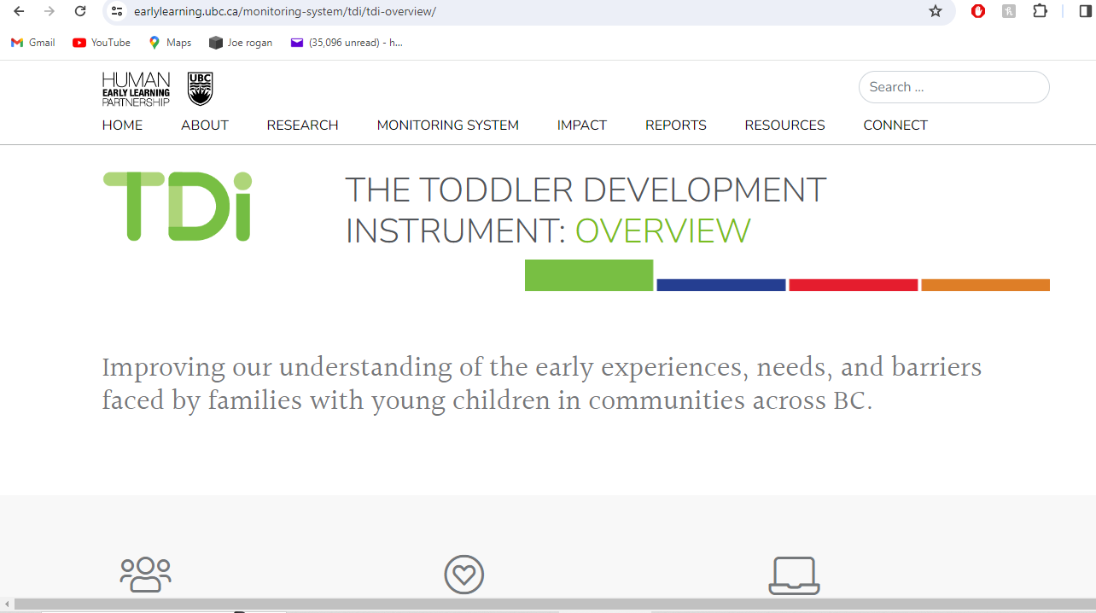

Slide 42
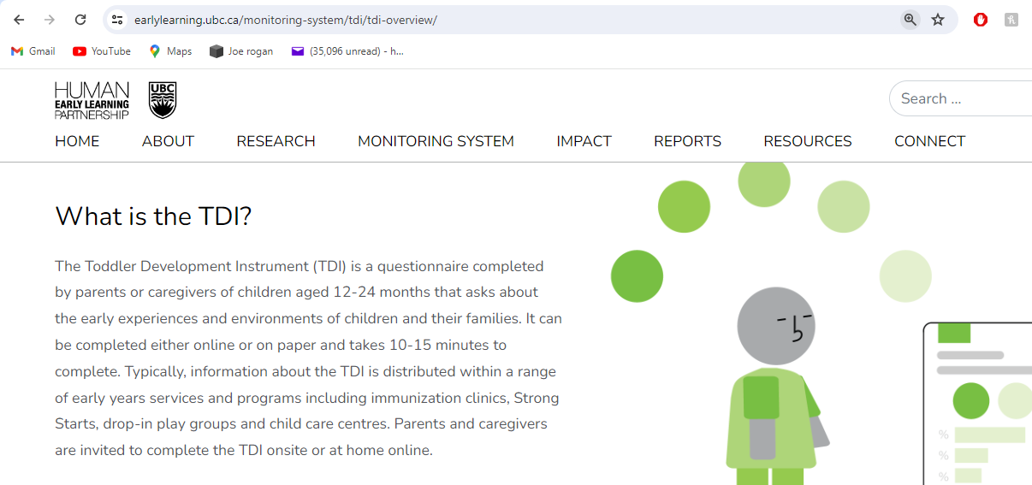

Slide 43
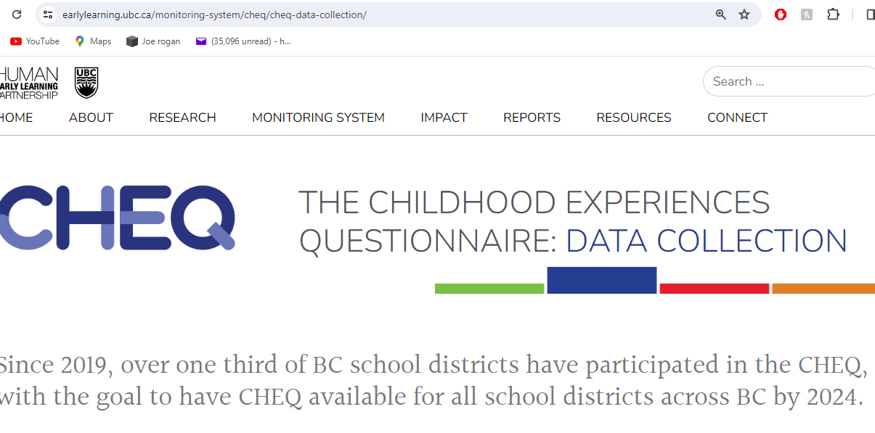

Slide 44
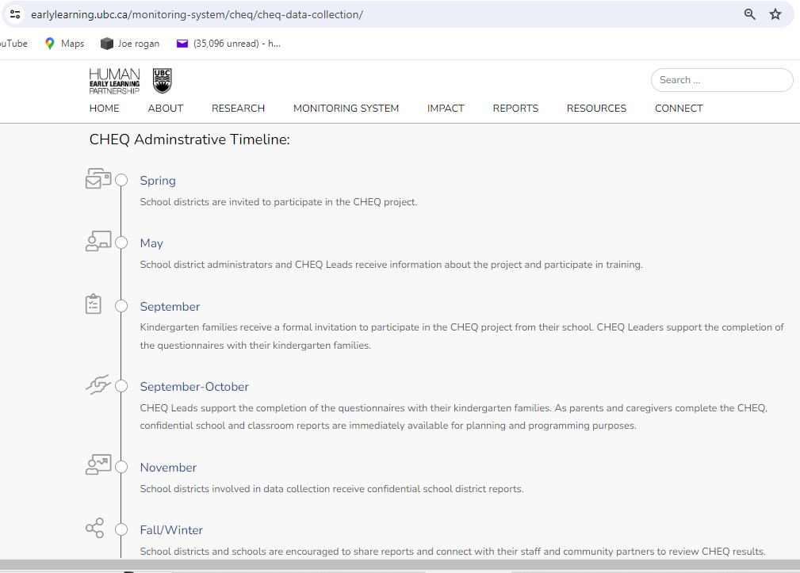

Slide 45
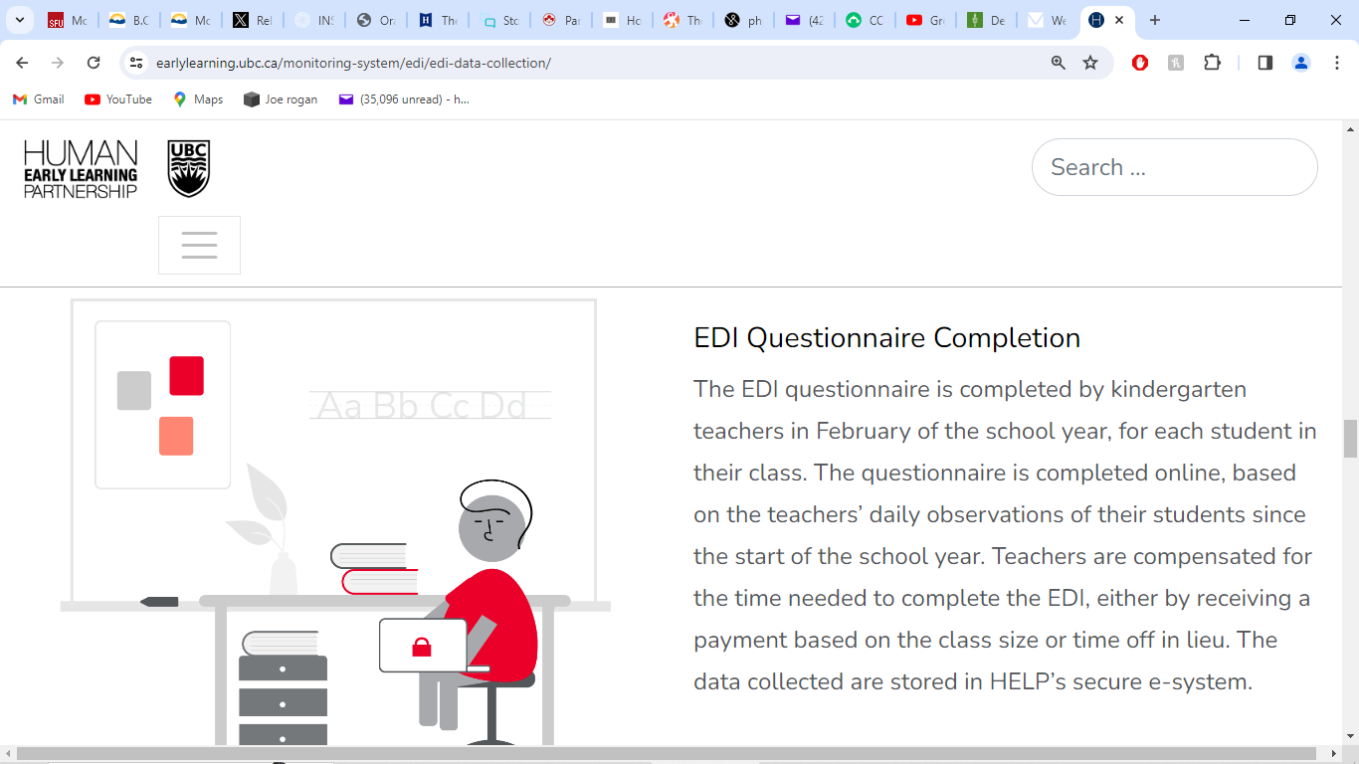

Slide 46
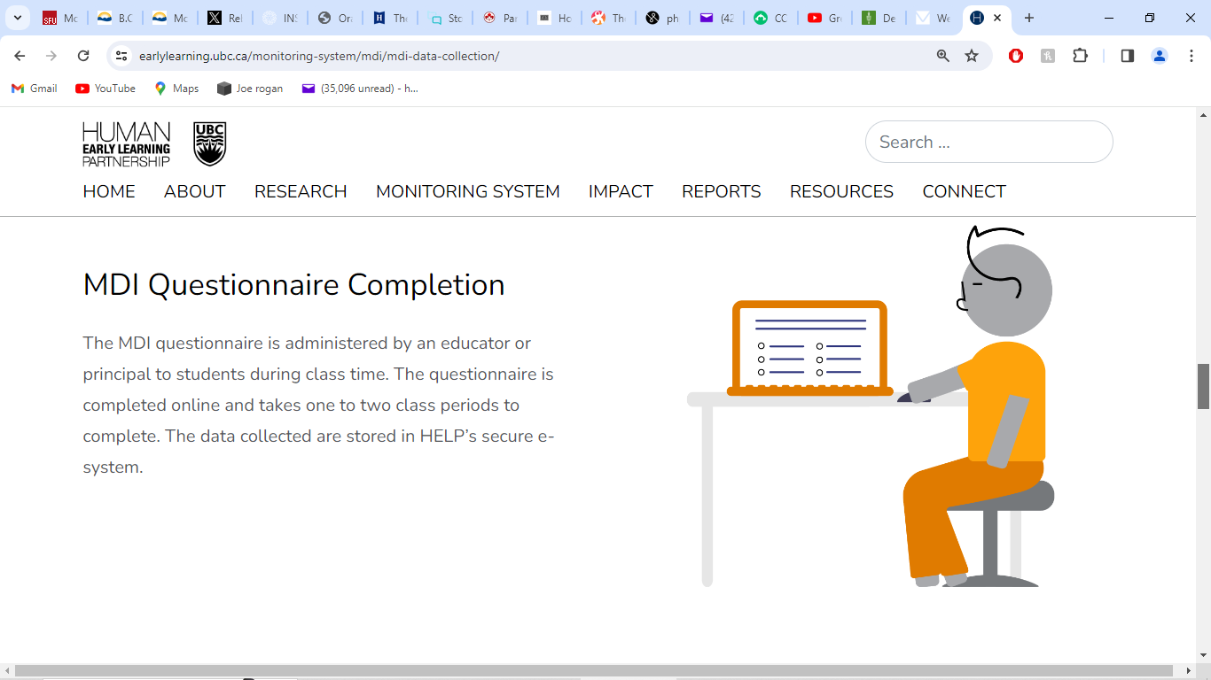

Slide 47


Slide 48
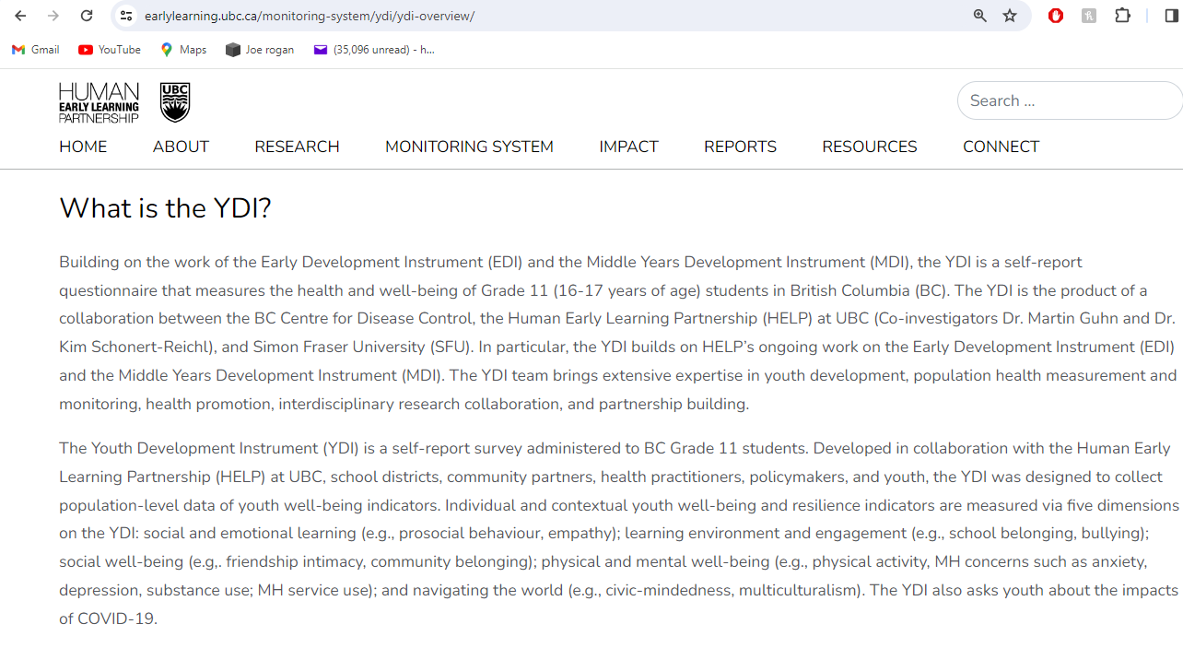

Slide 49
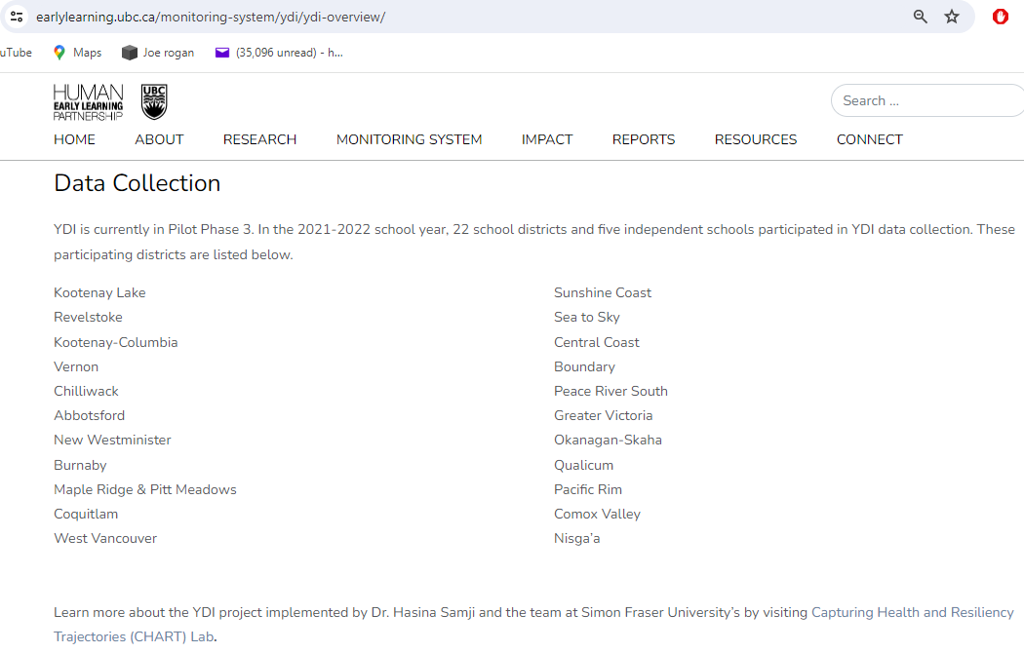

Slide 50
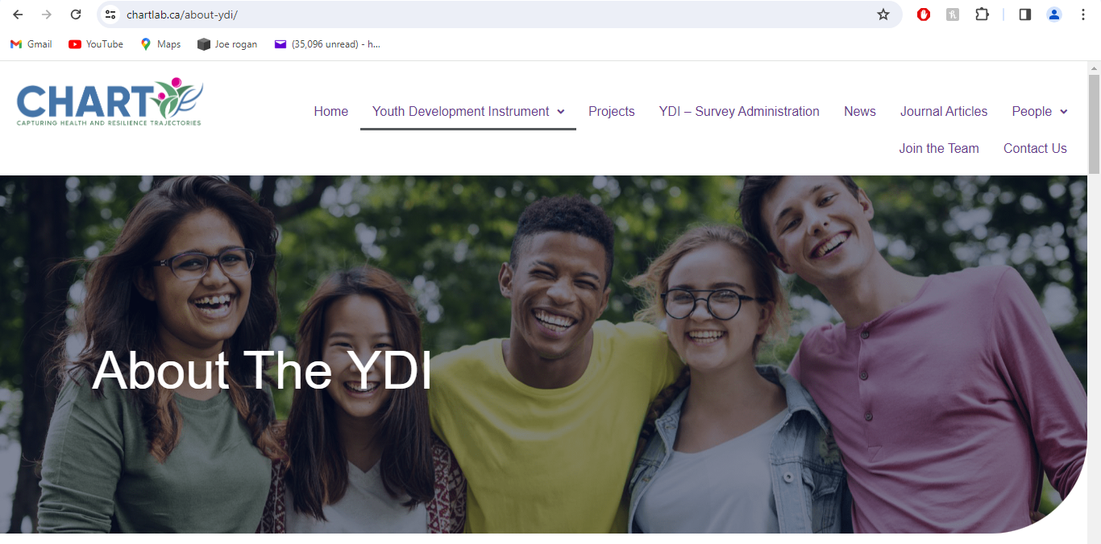

Slide 51
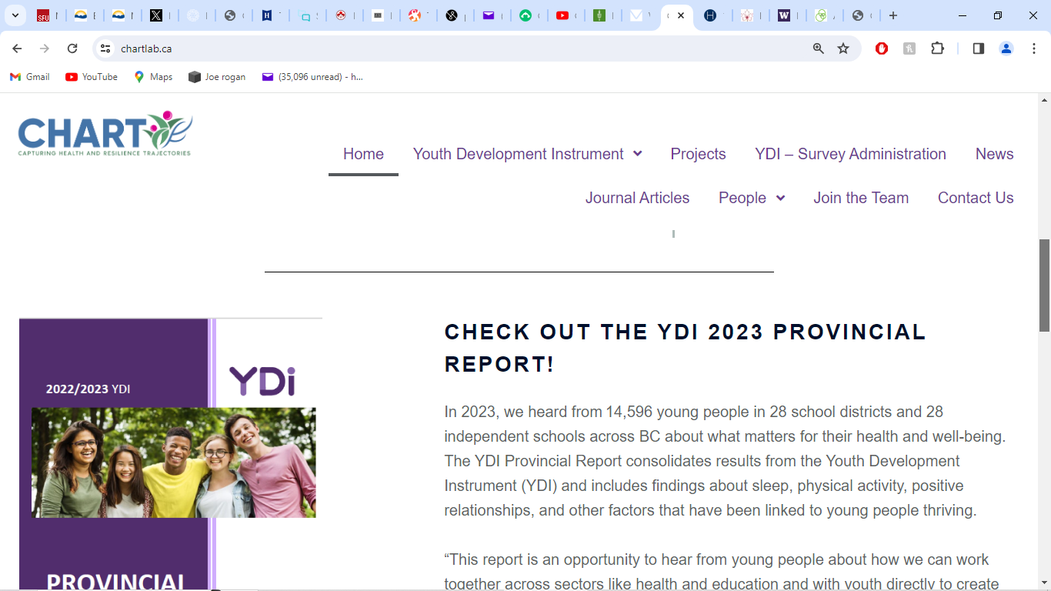

Slide 52
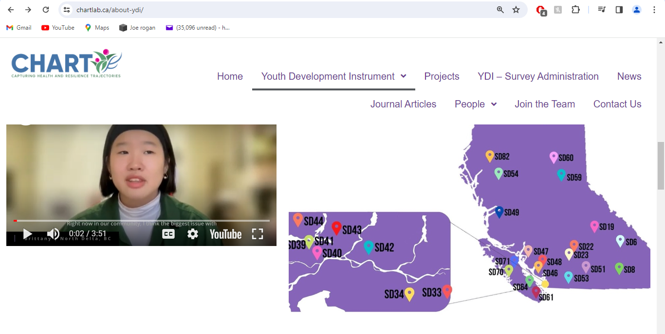

Slide 53
“PASSIVE CONSENT”
= NO CONSENT

Slide 54
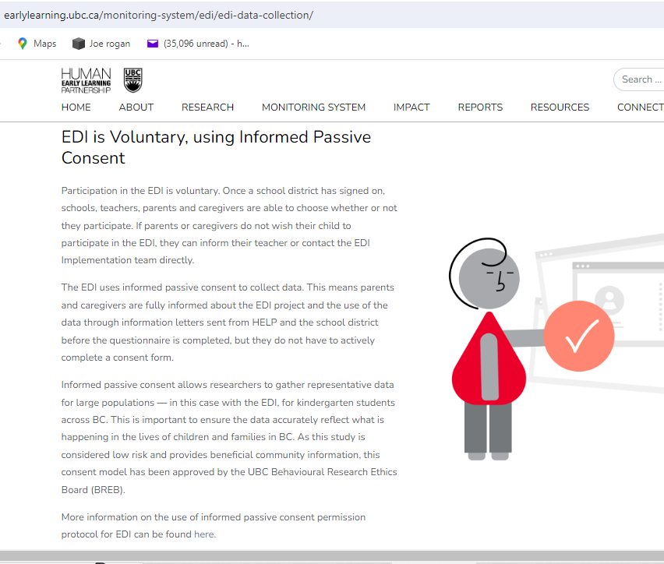

Slide 55
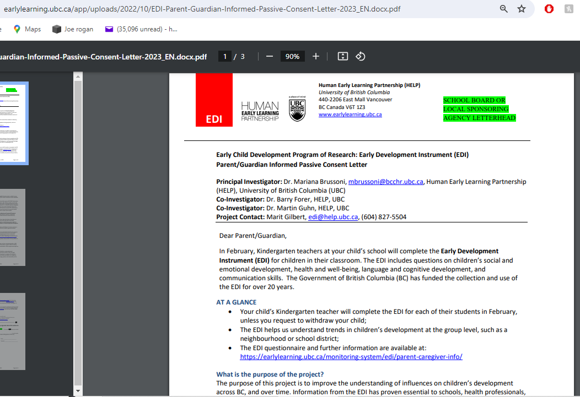

Slide 56
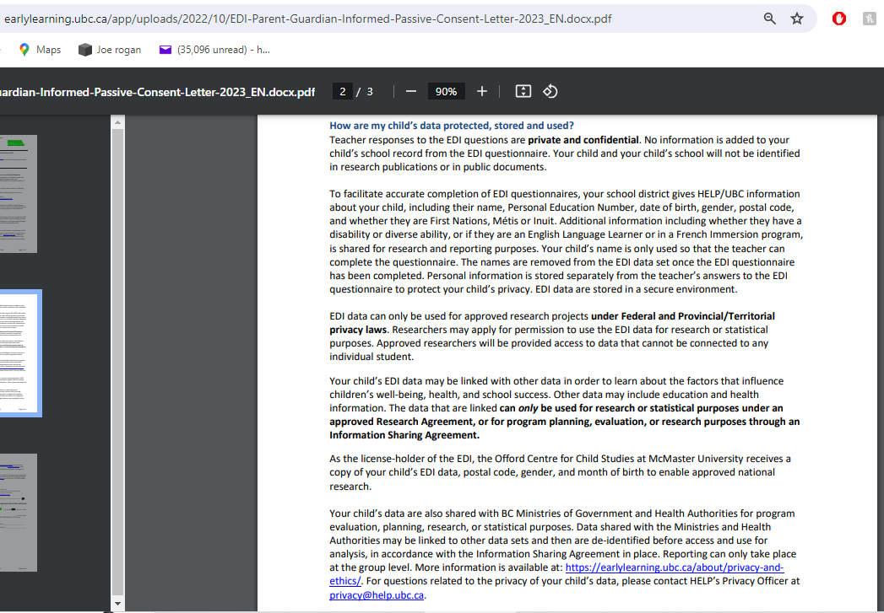

Slide 57
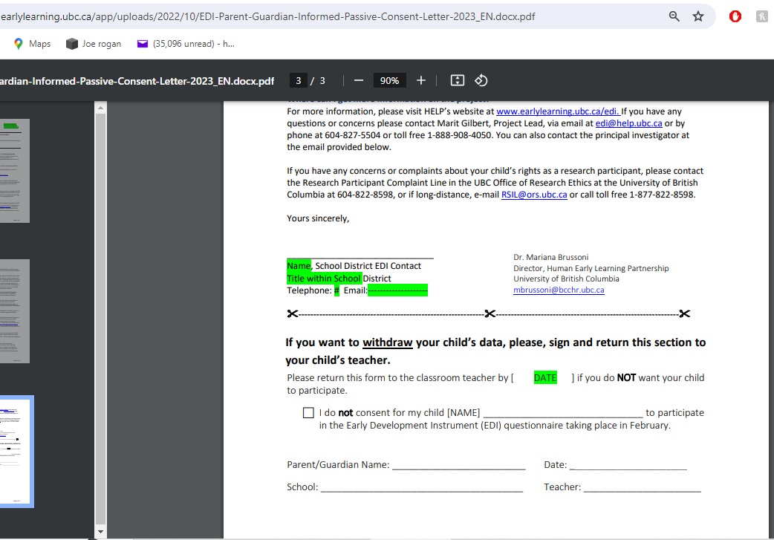

Slide 58
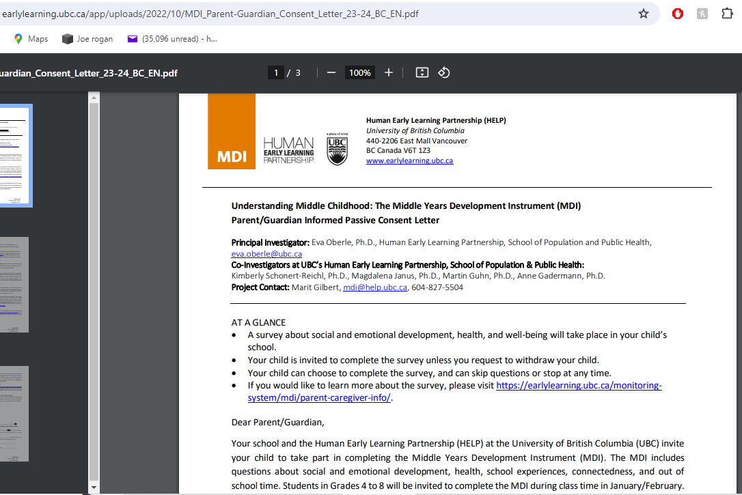

Slide 59
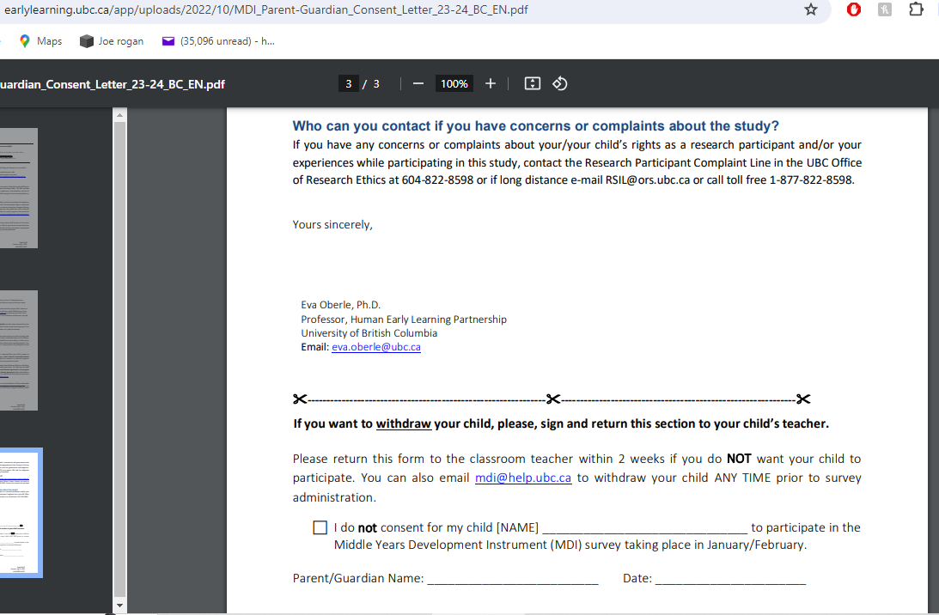

Slide 60
WHY THEY USE “PASSIVE CONSENT”
THEY ARE VERY SENSITIVE TO THE ILLEGAL COLLECTION AND LINKING OF OUR DATA

Slide 61
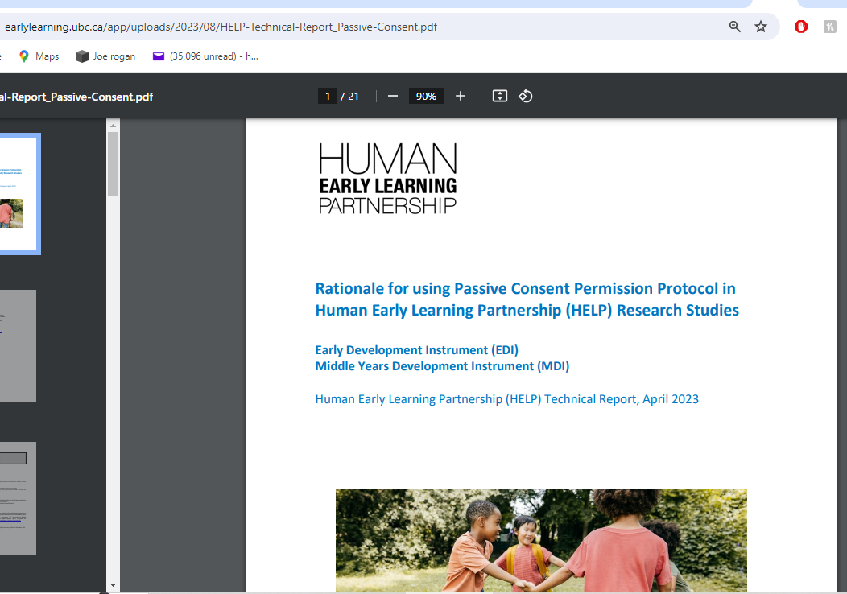

Slide 62


Slide 63


Slide 64
LEGAL REQUIREMENT: MEANINGFUL CONSENT
PRIVACY COMMISIONER OF CANADA

Slide 65


Slide 66


Slide 67


Slide 68
THE EDI QUESTIONAIRE

Slide 69


Slide 70


Slide 71


Slide 72


Slide 73


Slide 74


Slide 75


Slide 76


Slide 77


Slide 78


Slide 79


Slide 80


Slide 81
THE MDI QUESTIONNAIRE
GRADE 4-5

Slide 82


Slide 83


Slide 84


Slide 85


Slide 86


Slide 87


Slide 88


Slide 89


Slide 90



Slide 91


Slide 92



Slide 93


Slide 94


Slide 95


Slide 96


Slide 97


Slide 98
THE MDI QUESTIONAIRE GRADE 6,7,8

Slide 99


Slide 100


Slide 101
WHO ARE THESE PEOPLE?
HELP STAFF

Slide 102


Slide 103


Slide 104
H.E.L.P. BACKGROUND
LOBBYING FOR $10/DAY DAYCARE & ALL-DAY KINDGERTEN in Canada with the
WORLD BANK
&
WORLD HEALTH ORGANIZATION

Slide 105
World Bank 2005
RBC VP Charlie Coffee speech
Early Child Development is a Business Imperative
“…early child development is being recognized ‘as an industry
worthy of investment and important to economic growth.
It has fostered new relationships with business and government policy makers
and economic development experts. It has the potential to spawn
new approaches to data collection, planning, professional development,
management, finance, government policy, and advocacy.’ “
https://documents1.worldbank.org/curated/en/536021468340243580/text/409250PAPER0Ea101OFFICIAL0USE0ONLY1.txt

Slide 106


Slide 107


Slide 108
ARE KIDS OUTCOMES BETTER WITH HELP?
Worsening outcomes for child-wellbeing in all areas
HELP is lead lobbyist for:
$10 daycare
all day kindergarten
full-time ‘labour force attachment’ for all parents
No support for:
Breastfeeding
Parent-child attachment
Reducing screen time

Slide 109


Slide 110


Slide 111


Slide 112


Slide 113


Slide 114


Slide 115


Slide 116


Slide 117


Slide 118


Slide 119


Slide 120
WHAT TO DO?

Slide 121
WHAT TO DO?
Parents, students, teachers, anyone
First, make a FORMAL COMPLAINT to the SCHOOL PRINCIPAL
and DISTRICT SUPERINTENDENT
so you can make a FORMAL COMPLAINT to the
BC OFFICE OF INFORMATION AND PRIVACY COMMISSIONER
https://www.oipc.bc.ca/
THIS COULD BE A JOINT COMPLAINT – WORK TOGETHER!
GET HELP WITH THIS – contact info@kidsfirstcanada.org

Slide 122


Slide 123
WHAT TO DO?
IN THE COMPLAINT: include
PopDataBC has no consent to collect, link, sell our data
That passive consent is not consent
HELP’s parent letters and student info is misleading and incomplete
Students are in a coercive environment in school
No check to see if parents even got or read the letter
The letter does not even mention PopDataBC let alone the full extent of the data ‘linkage’
That you did not get the letter/email
That the purpose of school is not behavioural research or data mining BC residents

Slide 124
WHAT TO DO?
EMAIL you child’s teacher and principal to refuse the EDI, MDI, YDI, & CHEQ and to exclude your child
Contact MLAs and MPs
Demand that PopDataBC be de-funded all data held destroyed
Demand that HELP’s ‘Monitoring systems’ be de-funded and all data destroyed
Demand and apology to all BC residents from BC Gov’t, UBC, and from researchers working for HELP and PopDataBC
Tell everyone – everyone’s privacy is violated

Slide 125


