Slide 1
‘Mature Minors’?
BC Infants Act
&
Federal Policies
Helen Ward
President, Kids First Parent Association of Canada
Tuesday April 22, 2025
Burnaby Town Hall

Slide 2

OUR PURPOSES
1 – support for children’s optimal well-being
2 – support & recognition for parental care of children

Slide 3
QUESTIONS FOR YOU…
At what age can a child get ‘health care treatment’ without parental consent in BC?
How can we know if someone is ‘mature’?
What happens to staff when they let a child make a health care decision and the child suffers harm?

Slide 4
Outline
What is the BC Infants Act?
Changes to BC Infants Act
Legal Interpretation Infants Act
Other interpretations of Infants Act
Federal policies & the Infants Act
Effects of the Infants Act
What can be done?

Slide 5
WHAT IS THE BC INFANTS ACT?

Slide 6
What is BC’s Infants Act?
…imported to BC from British laws (in 1920s?)
…dates back to King Charles II 1600s
…for children whose parents had died – orphans
…the crown would manage orphans’ contracts, property & assets
NO mention of consent to medical treatment until 1973

Slide 7
What is ‘consent to medical treatment’?
Informed consent is required before ANY ‘health care’ treatment
Providing medical treatment without informed consent is ASSAULT.
Except in an emergency eg patient is unconscious…
Medical doctors are concerned about LIABILITY.

Slide 8
What is an ‘infant’?
An ‘infant’ is a minor…currently:
Under 19
British Columbia, New Brunswick, Newfoundland, Northwest Territories, Nova Scotia, Nunavut, and Yukon
Under 18
Alberta, Manitoba, Ontario, Prince Edward Island, Quebec, and Saskatchewan
Child support for children at or over the age of majority - Part 2: Child Support Continued(2) - Putting Children's Interest First - Federal-Provincial-Territorial Consultations on Custody and Access and Child Support

Slide 9
CHANGES TO THE BC INFANTS ACT

Slide 10
Amendments
1970
1970 – lowered age of majority from 21 to 19 in BC
Following other major changes in medical treatment:
- 1968 - publicly funded medical care begins in BC
1969 - abortion was made legal with restrictions in Canada

Slide 11
Amendments
1973
1973 – new section added: Consent to medical treatment
MDs and dentists permitted for the first time to allow minors to consent without parental consent
Doctors lobbied for amendment so they could avoid criminal liability (assault) for providing birth control and abortions to girls without parental consent
There was much debate in Victoria about the proposed changes including to limit age and to contact parents

Slide 12
Amendments
1973
WHO? Limited to licensed Medical Doctors and Dentists
Required to attempt to contact parents
AGE? Limited to age 16, 17, 18

Slide 13
Amendments
1992
‘Medical consent’ section radically altered
Expands definition of “health care” & “health care provider”
REMOVED:
All age limits
Requirement to contact parents

Slide 14
BC INFANTS ACT
Section 17 - CONSENT TO MEDICAL TREATMENT
(1)In this section: "health care" means anything that is done for a therapeutic , preventive, palliative, diagnostic, cosmetic or other health related purpose, and includes a course of health care;"
"health care provider" includes a person licensed, certified or registered in British Columbia to provide health care.
http://www.bclaws.ca/civix/document/id/complete/statreg/96223_01#section17

Slide 15
BC INFANTS ACT
Section 17 - CONSENT TO MEDICAL TREATMENT
(2)Subject to subsection (3), an infant may consent to health care whether or not that health care would, in the absence of consent, constitute a trespass to the infant's person, and if an infant provides that consent, the consent is effective and it is not necessary to obtain a consent to the health care from the infant's parent or guardian.
(3)A request for or consent, agreement or acquiescence to health care by an infant does not constitute consent to the health care for the purposes of subsection (2) unless the health care provider providing the health care
(a)has explained to the infant and has been satisfied that the infant understands the nature and consequences and the reasonably foreseeable benefits and risks of the health care, and
(b)has made reasonable efforts to determine and has concluded that the health care is in the infant's best interests.

Slide 16
What’s not in the Infants Act…
There is no mention of ‘mature minor’ in the law
There is no mention of excluding parents from getting information about their children’s ‘health care’
There are no details about the process by which ‘health care providers’ (HCP) are to be ‘satisfied’ that a minor understands the proposed treatment
Or what a HCP’s “reasonable efforts” should include to conclude” that the proposed treatment is in the minor’s “best interests”

Slide 17
How was the 1992 amendment made law?
…according to the Hansard record of debates in the BC Legislature…
Brought in by new NDP government
There was NO debate
There was no opposition
The controversial amendment was hidden in an ‘omnibus’ ( = catch all) ‘housekeeping’ bill (unimportant details updated)
Opposition was outraged when they found out they’d been ‘tricked’
The lack of debate & consultation ensured that the law was hastily and badly made and lacked involvement of parents, health care providers, lawyers, parent groups, human rights groups, etc

Slide 19
LEGAL INTERPRETATION OF THE INFANTS ACT

Slide 20
1992 amendment challenged in court
In 1993 there was a Charter Challenge to the 1992 amendment
Claimed it violated parents’ and children’s Charter Rights
Dr Philip Ney was one complainant of many medical personnel and parents

Slide 21
1993 Ney case
Judge ruled the law did not violate Charter because…
For a health care Provider to be ‘satisfied’ that health care was in a minor’s ‘best interests’ …
‘concerned parents will be consulted’ due to need …
To know medical history
To know drug allergies
To have needed follow up care
To pay for needed follow up care
…and…
http://www.courts.gov.bc.ca/jdb-txt/sc/93/05/S93-0597.htm

Slide 22
1993 Ney case
“In virtually all of the factual circumstances suggested in argument or set out in the affidavits as causing anxiety to the plaintiffs as health care providers and parents, those "reasonable efforts" will include consultation with concerned parents because such consultation will be required to determine that the "health care is in the infant's best interests": I am thinking in particular of circumstances where the prior medical history is required, where questions of sensitivity to drugs might be involved, where the post-treatment care by responsible adults will be needed, where the child's parents must bear responsibility for the costs of care.”

Slide 23
1993 Ney case
“If health care is to be in a child's best interests, health care providers will need to be sensitive to and respect the culture and particularly the belief systems of the family of which the child continues to be a member,
and certainly, all health care providers must be aware of the importance of family relationships to the emotional, physical, and spiritual well-being of their patient.”

Slide 24
1993 Ney case
“Courts have found comfort in placing the responsibility for deciding what is in the best interests of a child with regard to health care in the hands of medical practitioners for they know that medical practitioners will be held accountable by their professional body if they fail to properly discharge this responsibility.”

Slide 25
1993 Ney case
“That result ought not to be regarded as a licence for doctors to disregard the wishes of parents on this matter whenever they find it convenient to do so. Any doctor who behaves in such a way would be failing to discharge his professional responsibilities, and I would expect him to be disciplined by his own professional body accordingly. The medical profession have in modern times come to be entrusted with very wide discretionary powers going beyond the strict limits of clinical judgement and there is nothing strange about entrusting them with this further responsibility which they alone are in a position to discharge satisfactorily”.

Slide 26
Is the Ney ruling followed?
The judge’s ruling is systemically ignored
Parents are not ‘consulted’ as the legal interpretation clearly requires
‘Doctors’ and other HCPs have not been disciplined for their conduct
Health care & other government agencies refuse to give parents information if the child wants to keep secrets

Slide 28
OTHER INTERPRETATIONS OF THE INFANTS ACT

Slide 29
What does ‘mature’ mean?
You tell me.
There are no tests for ‘maturity’ that are objective or reliable
Many or most legal adults are not ‘mature’
Assessing ‘maturity’ would inherently require excessive state intrusion, constant re-assessment
‘Maturity’ is not a legal concept at all; it is a psychological & spiritual concept

Slide 30
What is required for health care providers to determine that a minor can consent to treatment?
Different agencies have different policies
because Ney ruling is ignored and law is vague

Slide 31
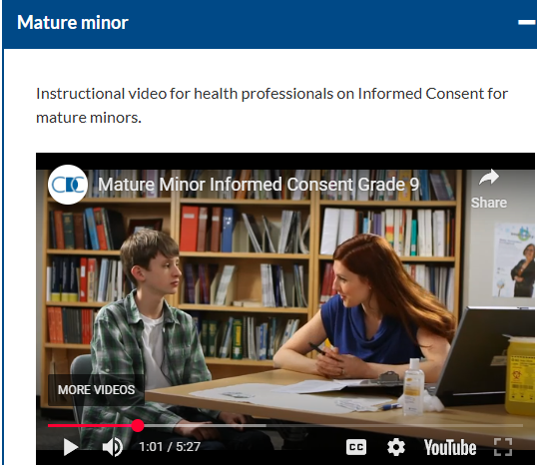
BC Centre for Disease Control
Video on Mature Minor Consent Procedure
https://youtu.be/lsnRHdT5ls0?si=2ZWshUGiMtRwnluv

Slide 32
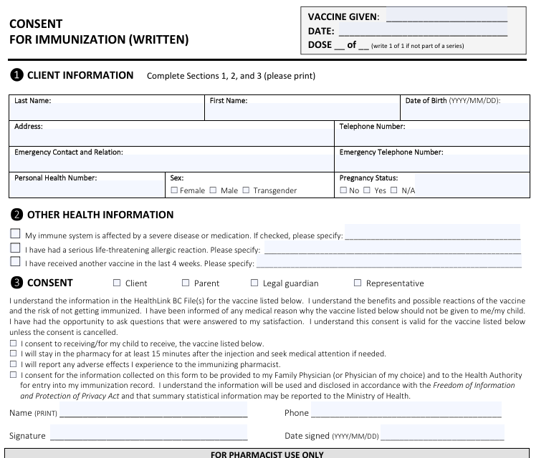
Vaccine Consent Form_092818_fillable.pdf

Slide 33
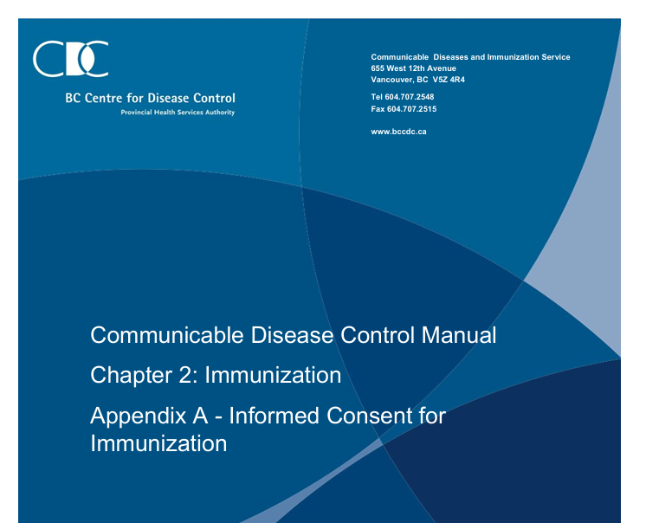
BC CDC
Step 1: Determine Authority to Provide Informed Consent
Appendix_A_InformedConsent.pdf

Slide 34
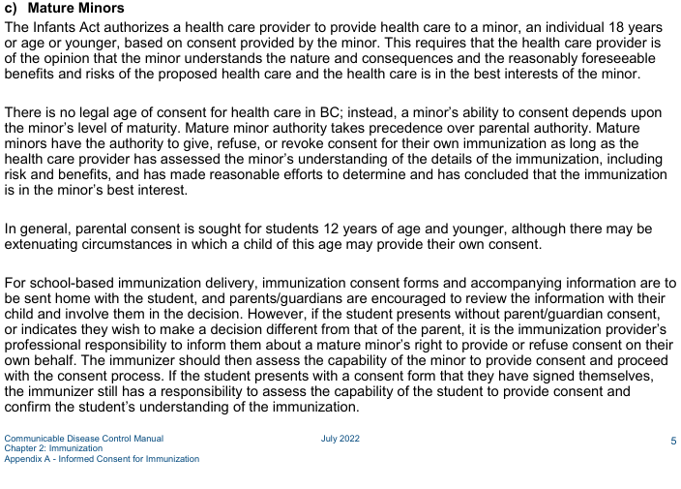

Slide 35
Coastal Health Region – Vancouver, North Van
I could not find their policies on obtaining consent

Slide 36
Fraser Health Region policy (Burnaby to Hope)
PRESUMPTION OF CAPABILITY
Every patient is presumed capable of making decisions about their health care until the contrary is demonstrated, including patients who are minors (see below).
If a patient’s capability is in question, the health care provider must assess the patient to determine whether the patient demonstrates an understanding of the information provided to the patient about the nature, consequences and alternatives of the proposed health care; and that the information applies to the patient’s own situation.
One method of determining the patient’s understanding is to have the patient explain in their own words or manner the proposed treatment, its risks and benefits, and alternatives to the proposed treatment and the risks and benefits of those alternatives. When dealing with the elderly, or those deemed incapable of consenting, the health care provider should still involve the patient in making decisions about their health care to the greatest extent possible. The health care provider must document the observations that form the basis for the assessment in the Health Record.

Slide 37
Fraser Health Region policy (Burnaby to Hope)
https://www.fraserhealth.ca/-/media/Project/FraserHealth/FraserHealth/About-Us/Accountability/Policies/ConsentForHealthCare-Policy.pdf
“Valid Consent: consent that has been voluntarily given by a patient (or their authorized decision maker) who: is legally capable of giving consent; has been fully informed about the nature of the proposed care (including how it relates to the patient’s condition), the risks, benefits, and any available alternatives to the proposed care (including the option of no care); and has been given an opportunity ask questions and receive answers about the proposed care and the available alternatives to the proposed care (including the option of no care).”

Slide 38
Fraser Health Region policy (Burnaby to Hope)
COMMUNICATING CONSENT
The patient may communicate their consent to the proposed health care verbally, in writing, or by their conduct (implied consent). …
Consent for proposed health care may be obtained from a patient virtually

Slide 39
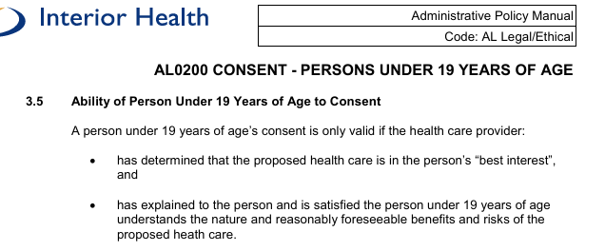
Interior Health Authority

Slide 40
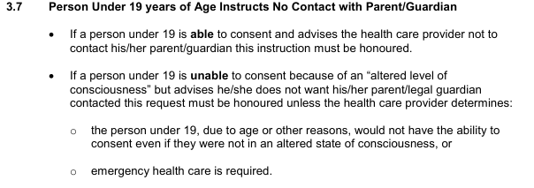
Interior Health Authority

Slide 41
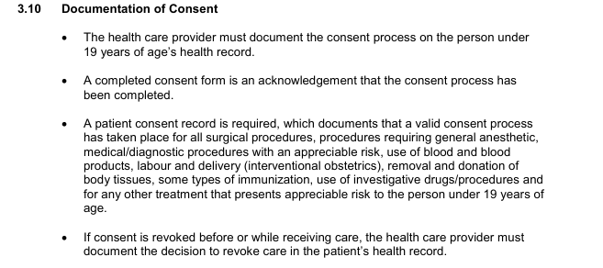
Interior Health Authority

Slide 42
Canadian Medical Association
CMA CODE OF ETHICS AND PROFESSIONALISM
13. Recognize the need to balance the developing competency of minors and the role of families and caregivers in medical decision-making for minors, while respecting a mature minor’s right to consent to treatment and manage their personal health information.

Slide 43
Canadian Medical Protective Association:
Consent: A guide for Canadian physicians
The CMPA assists physicians with medico-legal issues, enhances patient safety, and compensates patients harmed by negligent care
Age of consent
The legal age of majority has become progressively irrelevant in determining when a young person may consent to his or her medical treatment. As a result of consideration and recommendations by law reform groups as well as the evolution of the law on consent, the concept of maturity has replaced chronological age. The determinant of capacity in a minor has become the extent to which the young person's physical, mental, and emotional development will allow for a full appreciation of the nature and consequences of the proposed treatment, including the refusal of such treatments.
Legislation in a number of provinces and the territories has codified the law on consent, including the reliance on maturity in assessing a young person's capacity to consent to or refuse medical treatment. Only the Province of Quebec has established a fixed age of 14 years, below which the consent of the parent or guardian or of the court is necessary for the purposes of proposed treatment.
Generally, where the minor patient lacks the necessary capacity, the parents or guardian are authorized to consent to treatment on the minor's behalf. In doing so, the parents or guardian must be guided by what is in the best interests of the minor. This consideration becomes all the more important when the parent or guardian seeks to refuse treatment the physician regards as medically necessary. In these circumstances, there is an obligation on the part of physicians to report the matter to child protection authorities.
Patients must be at least 18 years of age to consent to medical assistance in dying. A minor patient’s parents or guardian cannot consent to assistance in dying on the minor’s behalf

Slide 44
What does the Supreme Court of Canada say? 1995 B(R) case
“The right to nurture a child, to care for its development, and to make decisions for it in fundamental matters such as medical care, are part of the liberty interest of a parent.
The common law has long recognized that parents are in the best position to take care of their children and make all the decisions necessary to ensure their well-being.
This recognition was based on the presumption that parents act in the best interest of their child.
In recent years, courts have expressed some reluctance to interfere with parental rights… confirming that the parental interest in bringing up, nurturing and caring for a child, including medical care and moral upbringing, is an individual interest of fundamental importance to our society.”
995 B. (R.) v. Children's Aid Society of Metropolitan Toronto http://scc-csc.lexum.com/scc-csc/scc-csc/en/item/1220/index.do

Slide 45
What does the Supreme Court of Canada say? 1995 B(R) case
• “While parents bear responsibilities toward their children, they must enjoy correlative rights to exercise them .
• “…parents should make important decisions affecting their children both because parents are more likely to appreciate the best interests of their children and because the state is ill-equipped to make such decisions itself.”

Slide 46
What does the Supreme Court of Canada say? 1995 B(R) case
“…[children] are unable to assert these [Charter] rights, and our society accordingly presumes that parents will exercise their freedom of choice in a manner that does not offend the rights of their children.
• …state interference in order to balance the rights of parents and children will arise only in exceptional cases. The state can properly intervene in situations where parental conduct falls below the socially acceptable threshold….”

Slide 48
FEDERAL POLICIES

Slide 49
Federal government approves
Provinces deliver
Federal government approves pharmaceutical drugs including vaccines
Provinces create vaccine ‘schedules’ & recommendations
Minors can consent to any approved drug
COVID-19 immunizations - Province of British Columbia

Slide 50
Federal Drug Policies
Federal government ‘safe supply’ gave drug users illegal drugs.
Addicts not required to use drugs under eye of pharmacist, ‘take out’.
‘Diversion’ of drugs means addicts took the free federal drugs and sold them to minors to buy fentanyl.
Minors got addicted, overdosed, some died.
Federal and BC government denied this was happening until BC finally ending ‘take out’ policy Feb 2025.

Slide 51
Medical Assistance in Dying (MAiD)- doctors assisting suicide
Plan to allow MAiD for minors (under 18 ie age 17 and under) was delayed
If approved, minors would be able to have a doctor kill them by lethal injection without parents’ knowledge or consent

Slide 52
Medical Assistance in Dying (MAiD)- doctors assisting suicide
Supreme Court of Canada
did nor approve a ‘mature minor’ 14-year-old Jehovah’s Witness’ refusal of a blood transfusion
the top court was unwilling to let the child die even against her wishes at that time: “right to life”

Slide 53
WHAT EFFECT DOES THE INFANTS ACT HAVE?

Slide 54
Concept creep
The so-called ‘mature minor’ concept has crept out of ‘health care’ into…
Child protection (Reena Virk in foster care by her choice was murdered)
School – let staff ignore parents and decide that kids decide
Youth Clinics
Youth Shelters

Slide 55
What actually happens?
Minors are incentivized by the state to cut out their parents.
Normal family conflict is weaponized by state.
This puts minors at extreme risk of harm not only from Health Care Providers but any government agent who decides they can replace parents.
Minors die. Minors overdose. Minors suffer. Families are destroyed.
If minors suffer, its their problem. HCPs are not liable.

Slide 56
What actually happens?
Government agency staff assume all minors are mature…
… even over the phone…
…even without ever seeing or talking to them.
Infants Act & policies required ‘assessment’ is rare.
School vaccine clinic nurses are now required to tell kids they don’t need parents to sign consent form.

Slide 57
Minors Refusing Addiction Treatment
A life and death issue

Slide 58

1995
Dianne Sowden’s 13 year old daughter addicted & trafficked on DTES

Slide 59
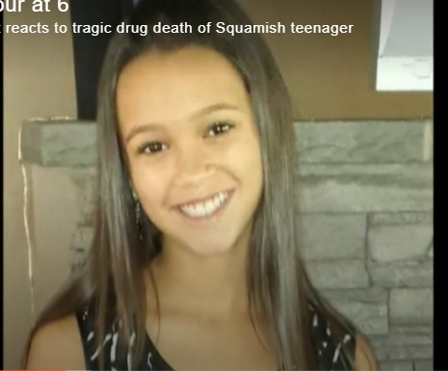
Stephanie Lawrence
Age 15 - January 2018 - Squamish, BC

Slide 60
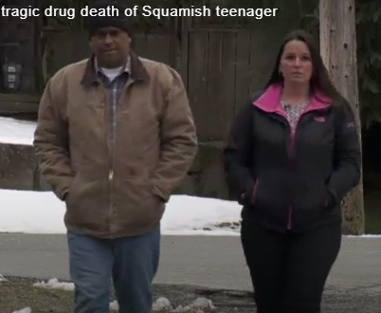
Stephanie’s parents

Slide 61

Allayah Thomas
May 2021 – age 12
‘I feel like we all failed her’: Grade 6 Saanich girl dies of suspected drug overdose
Allayah Thomas, who went by Ally, started experimenting with drugs last fall at just 11 years old. Her family says it escalated until she was using meth and heroin.
The Grade 6 Saanich student overdosed three times ending up at Victoria General Hospital, but her fourth overdose, at a friend’s house in Langford on April 14, proved fatal.
Ally’s grandparents, who she lived with, say all that the Grade 6 student was ever offered was counselling, which the young girl refused.
Grade 6 Saanich girl dies of suspected drug overdose

Slide 62

Kamilah Sword age 14 – 2023 - Vancouver

Slide 63
Staff hide information from parents

Slide 64
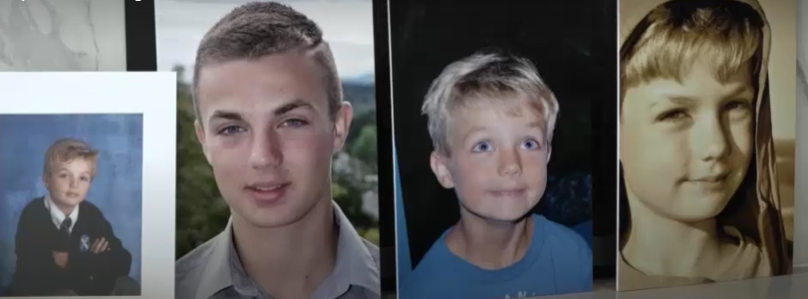
Elliot Eurchuk
Age 16 - April 2018 - Oak Bay, BC

Slide 65

Elliot’s parents: Rachel Staples
"I don't think anyone can understand the desperation," said Staples, wiping tears from her face.

Slide 66
His parents demanded change to Infants Act
“Elliot, being 16, was given full autonomy by the health care system to make his treatment decisions while specifically having my husband and I excluded from this information…. this policy needs to be changed. Parents need a say in their child’s health care.”

Slide 67
WHAT CAN BE DONE?

Slide 68
What can be done?
Strong relationship between parents & children
Inform medical staff, school staff, social workers in writing that it is illegal to
– 1 - allow your child to consent to or refuse health care treatment without your consent
– 2 - refuse to provide you with health information about your child .
It violates:
- Supreme Court of Canada’s decision on parental Charter right to liberty
- the Ney ruling on the Infants Act.

Slide 69
US $25M study of adolescent health…
“Reducing the Risk: Connections That Make a Difference in the Lives of Youth”
“Across all of the health outcomes examined, the results point to the importance of family and the home environment for protecting adolescents from harm. What emerges most consistently as protective is the teenager’s feeling of connectedness with parents and family. Feeling loved and cared for by parents matters in a big way.”

Slide 70
What can be done?
Organized legal action against the laws and policies
To enforce the Supreme Court of Canada’s ruling & Ney ruling
Complaints to professional associations – doctors, nurses, social workers, teachers, counsellors, etc.
Demand federal & provincial politicians revise & enforce the law and policies

Slide 71
QUESTIONS?
www.KidsFirstCanada.org
info@KidsFirstCanada.org
604-291-0088

